Slide 1
Real options and risk aversion using the integrated valuation procedure
Cameron MacKenzie, Assistant Professor IMSE
April 26, 2021

Slide 2
Public or market risks
Based on option theory in financing
Assumption that all risk can be mitigated by hedging
Use risk-free interest rate
Under these assumptions, any decision maker (risk neutral, risk averse, risk seeking) would have the same value for a real option

Slide 3
Can all risk be hedged in the market?
Integrated valuation procedure (Smith and Nau 1995, Smith and McCardle 1998)
If a risk is a market or public risk (i.e., can be perfectly hedged in the market) use risk-neutral probabilities and risk-free rate to calculate value of options
If a risk is a private risk that cannot be hedged in the market, use subjective probabilities and
Risk-free rate and expected NPV if decision maker is risk neutral
Risk-averse utility function if decision maker is risk averse
Smith, J. E. & Nau, R. F. (1995). Valuing risky projects: Option pricing theory and decision analysis. Management Science 41(5): 795-816.
Smith, J. E. & McCardle, K. F. (1998). Valuing oil properties: Integrating option pricing and decision analysis approaches. Operations Research 46(2): 198-217.

Slide 4
3-bus example over two years (from Nur, 2021)
 |  | Load at bus 1 | LMP at bus 1 | LMP at bus 2 | LMP at bus 3
Without generator at bus 1 | Year 1 | 270 | $8.045 | $7.85 | $7.97
 |  | 148 | $7.85 | $7.85 | $7.85
 | Year 2 | 365 | $8.045 | $7.85 | $7.97
 |  | 200 | $7.85 | $7.85 | $7.85
 |  | 110 | $7.85 | $7.85 | $7.85
With generator at bus 1 | Year 1 | 270 | $7.92 | $7.85 | $7.893
 |  | 148 | $7.85 | $7.85 | $7.85
 | Year 2 | 365 | $7.92 | $7.85 | $7.893
 |  | 200 | $7.85 | $7.85 | $7.85
 |  | 110 | $7.85 | $7.85 | $7.85
Nur, G. N. (2021). Evaluation of license for two years. Working presentation, Iowa State University, April 19.

Slide 5
Decision model (uncertainty in load, investment cost, and operations and maintenance)
Investment cost
O&M cost
Load at bus 1 in year 2
Load at bus 1 in year 1
Total cost
Purchase generator for year 2 if no purchase for year 1
Purchase generator for year 1

Slide 6
Decision tree
High investment cost
High O&M cost
Load = 365
Load = 270
Purchase generator for year 1
Load = 200
Low investment cost
Low O&M cost
Load = 148
High investment cost
Load = 110
Purchase generator for year 2
Don’t purchase generator for year 1
Load = 365
Load = 270
Low investment cost
Don’t purchase generator for year 2
Load = 200
Load = 148
Load = 110

Slide 7
Key assumptions
Horizon timeline: 2 years
Risk aversion modeled by an exponential utility function
Load
Load in year 2 depends on load in year 1 (probabilistically dependent)
Risk of load uncertainty (higher LMPs) can be perfectly hedged in the electricity market → risk attitude is irrelevant
Investment and O&M costs
Costs are annualized
O&M cost begins in year after investment cost (i.e., no O&M cost if generator purchased for year 2)
Risk of investment and O&M costs cannot be hedged → risk attitude is incorporated

Slide 8
Parameters
Annual discount rate = 5%
Generator’s lifetime = 30 years (used to annualize investment cost)
 | Value | Probability of high | Low | Probability of low
Load | up | 0.51 | down | 0.49
Investment cost (over 30 years) | $3M | 0.60 | $1M | 0.40
Annualized investment cost | $195,000 |  | $65,000
O&M cost | $400,000 | 0.70 | $200,000 | 0.30
 | Risk neutral | Moderate risk aversion | Very risk averse
Interpretation: Indifferent between $0 for certain and … | … 50% chance of $1M profit and 50% chance of $1M loss | … 52% chance of $1M profit and 48% chance of $1M loss | … 99% chance of $1M profit and 1% chance of $1M loss
Risk tolerance | Infinity | $10M | $200,000

Slide 9
Results
Expected discounted cost
Certain equivalent of discounted cost
 |  |  | Risk neutral | Moderate risk aversion | Very risk averse
Year 1 decision | Purchase generator |  | $111,406,681 | $111,407,210 | $111,430,402
 | Don’t purchase generator |  | $111,025,161 | $111,025,246 | $111,029,188
If generator is not purchased for year 1 and … |  | … load = 270 in year 1 | Purchase generator for year 2
 |  | … load = 148 in year 1 | Don’t purchase generator for year 2
If no generator is available |  |  | $111,068,328 | $111,068,328 | $111,068,328
Value of option to purchase generator |  |  | $43,167 | $43,082 | $39,140

Slide 10
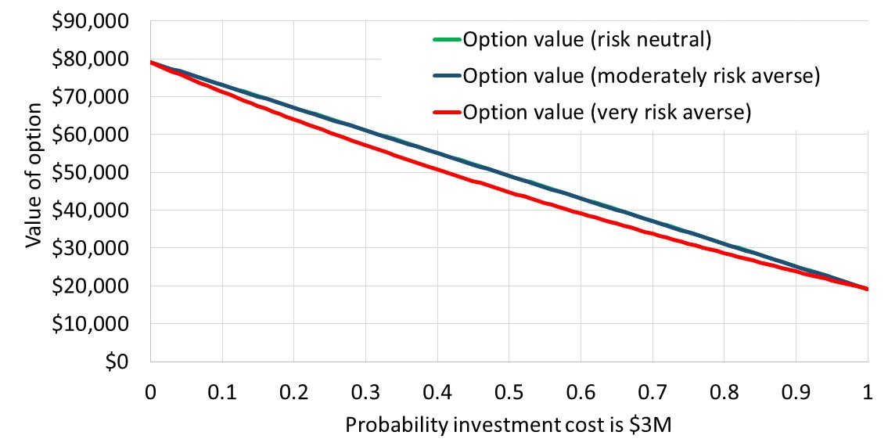
Sensitivity of option value to investment cost

Slide 11
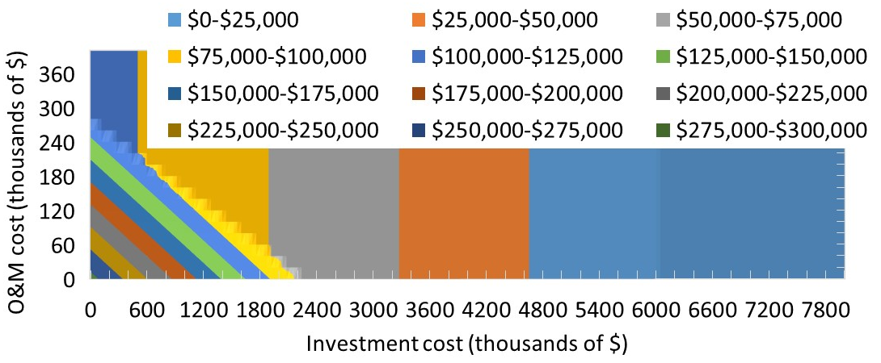
Value of option (moderately risk averse)
Low investment cost and low O&M cost is set to $0
Probability of high investment cost = 0.6
Probability of high O&M cost = 0.7

Slide 12
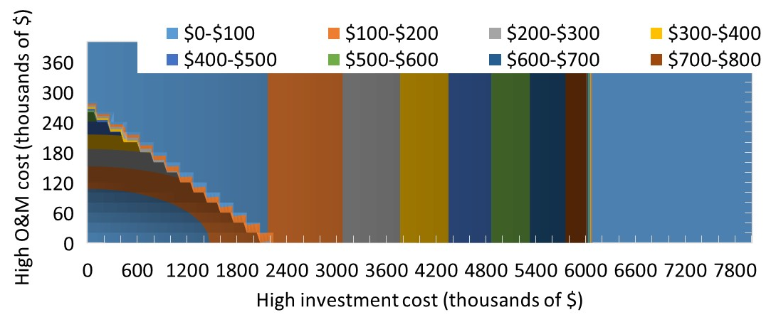
Difference in value of option between risk neutral and moderately risk averse

Slide 13
Difference in value of option between risk neutral and very risk averse

Slide 14
Time to purchase generator (moderately risk averse)
Purchase generator for year 2 if load = 270 in year 1
Never purchase generator
Purchase generator for year 1

Slide 15
Conclusions
Value of option (purchasing a generator) is relatively small compared to cost of generation for all risk attitudes
Cost of generation = $111M and maximum value of option = $300,000
The additional generator decreases the LMP by approximately $0.13
Difference between risk neutral and risk averse
Uncertainty in investment and O&M costs decreases the generator’s value to risk-averse decision maker
Maximum difference in value
$800 between risk neutral and moderately risk averse
$22,000 between risk neutral and very risk averse
Assumption: risk of increased load (larger cost of generation) can be perfectly hedged → how would results change if only some or none of that risk could be hedged?
High investment cost makes value worthless for any type of risk attitude

