Slide 1
Leasing land for a wind turbine: A model for a farmer’s decision
Cameron MacKenzie, Assistant Professor
Hanisha Vemireddy, PhD student
Fatemeh Amini, PhD graduate
SWEEET Public Workshop
August 8, 2022

Slide 2
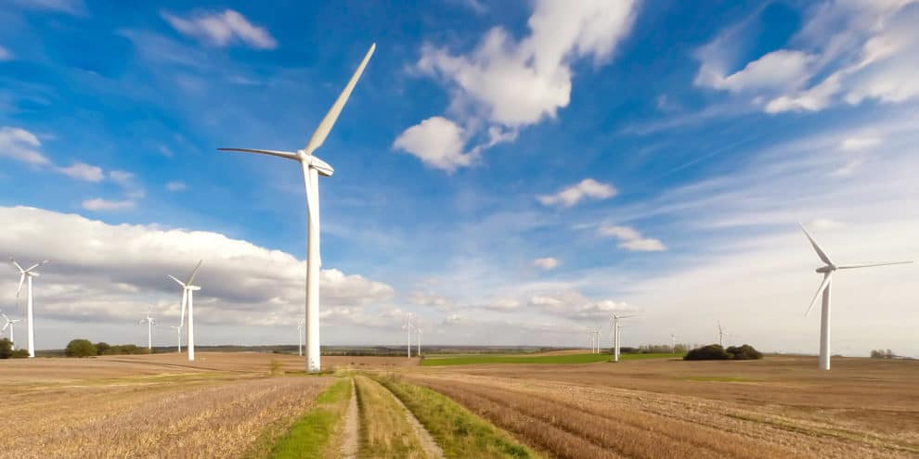
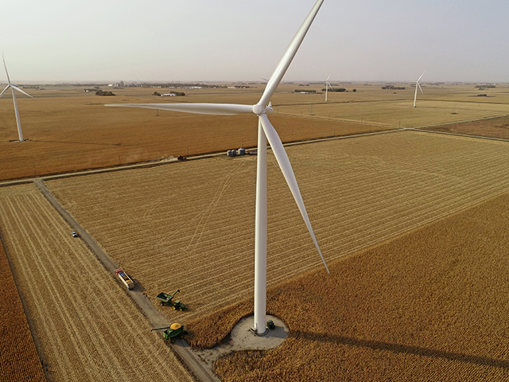
Wind turbines increasing in rural America
Notes:
As of Q3 2020, Iowa has over 10,951 megawatts (MW) of installed capacity with 5,590 wind turbines, ranking 2nd and 3rd in the nation below Texas respectively.^{[3]}
Nationally, $250M in lease payments for wind turbines

Slide 3
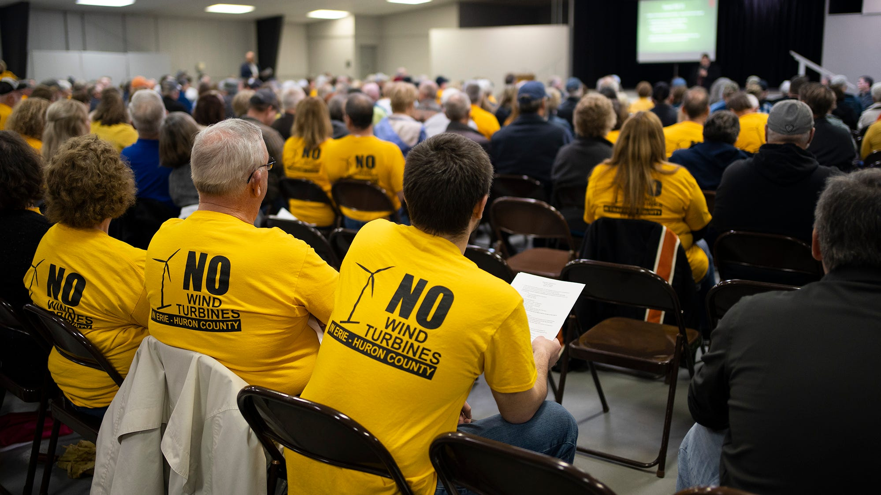
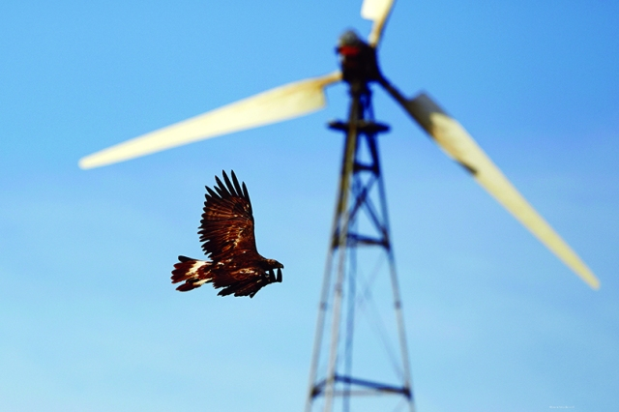
Opposition to wind turbines on farms

Slide 4
Variation in types of leases

Slide 5
Should a farmer lease land for a wind turbine?
Perspective of a financial decision
3 decisions
Should a famer allow exploratory work?
If developer wants to build a wind turbine,
Should a farmer agree to lease land?
If yes, fixed annual payment or royalty (percentage of revenue from wind)
At end of lease (20-30 years), should farmer renew the lease?

Slide 6
Uncertainties
Will wind developer want to install a wind turbine?
Will the county approve the wind turbine?
What revenue will be gained by leasing a turbine?
What revenue is the famer giving up by leasing a turbine?

Slide 7
Farmer’s decision model
Royalty percentage
Annual royalty payment
Fixed annual payment
Exploratory
work
Developer
approval
Lease land and type of lease
Net present value (NPV)
Renew lease or not
County
approval
Farm revenue

Slide 8
Assumptions in the model
30-year lease; renewal for 15 years
Discount rate (time value of money) = 5%
One 2 MW wind turbine with 25% capacity factor
Royalty based on amount of wind generated and mean wholesale electricity price
2-4% is royalty percentage
Initial electricity price = $58.08 / MWh; average annual increase = $0.43 / MWh
Turbine would replace 1 acre of corn farmland
Average = 205 bushels / acre; average annual increase = 2.1 bushels / acre
Initial corn price = $7.47 / bushel; average annual increase = $0.50 / bushel

Slide 9
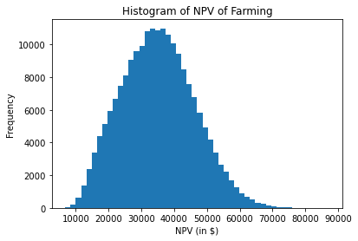
Farmer is always better financially to lease land than to reject wind turbine
Expected NPV = $48,000
Expected NPV = $122,000

Slide 10
Should farmer pursue an annual fixed payment for a turbine or a royalty payment based on wind revenue?
Depends on risk a farmer is willing to accept

Slide 11
A diversion on risk attitude
$10
0.5
0.5
-$5
Do you take the deal?

Slide 12
What if we increase the dollar values?
$10,000,000
0.50
0.50
-$5,000,000
Do you take the deal?

Slide 13
Indifference point
$w
0.5
$0 ~
0.5
-$w/2
What is the value of w that makes you indifferent?
Different w → different risk attitudes

Slide 14
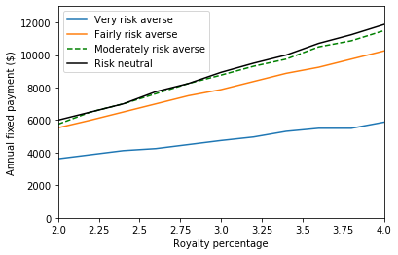
Fixed payment threshold for different royalty percentages and risk attitudes
Notes:
Very risk averse = $10,000
Fairly risk averse = $100,000
Moderately risk averse = $500,000

Slide 15
Insights
A farmer is better off financially leasing land for a turbine rather than rejecting lease
Farmer should often choose royalty payment unless
Farmer is very risk averse
Annual fixed payment is very good ($8,000 or more)

