Slide 1
Optimal Valuation of Project Options in Electric Power Generation and Transmission Planning
Cameron MacKenzie
Gazi Nazia Nur
Jay Sandeep Ghodke
Kyung Jo Min
Industrial and Manufacturing Systems Engineering
Iowa State University

Slide 2





How should we value new renewable energy resources?

Slide 3
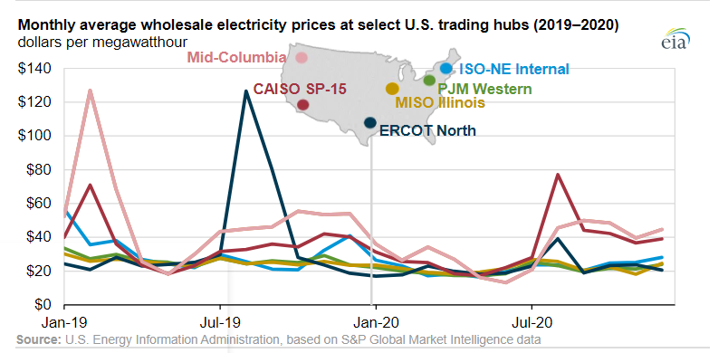
Electricity prices can be very volatile and uncertain

Slide 4







Solar and Wind Energy Using Engineering Economics Theory (SWEEET)
www.imse.iastate.edu/sweeet

Slide 5
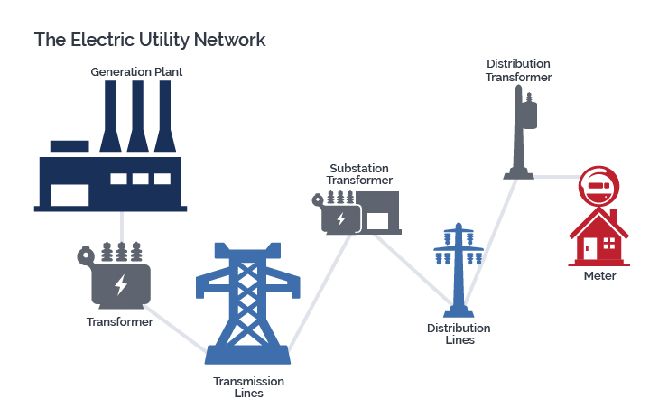
Optimal power flow model determines best operating levels for electric power generation
Objective: Minimize cost while meeting demand

Slide 6

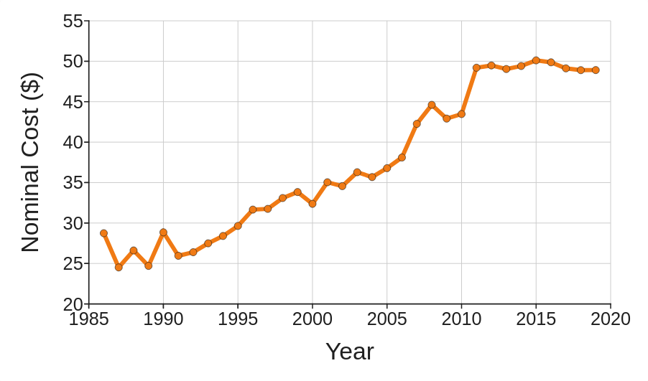
Real options give firms the right but not the obligation to undertake business opportunities
Timing / waiting option
Growth
option
Abandon / switch / install option

Slide 7

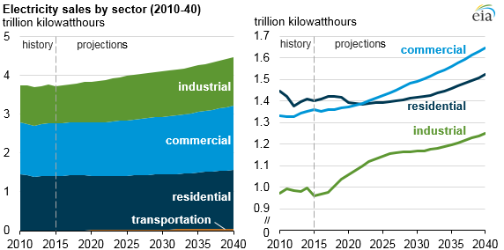

Adding new generation sources or transmission capacity is a critical part of power planning
7

Slide 8
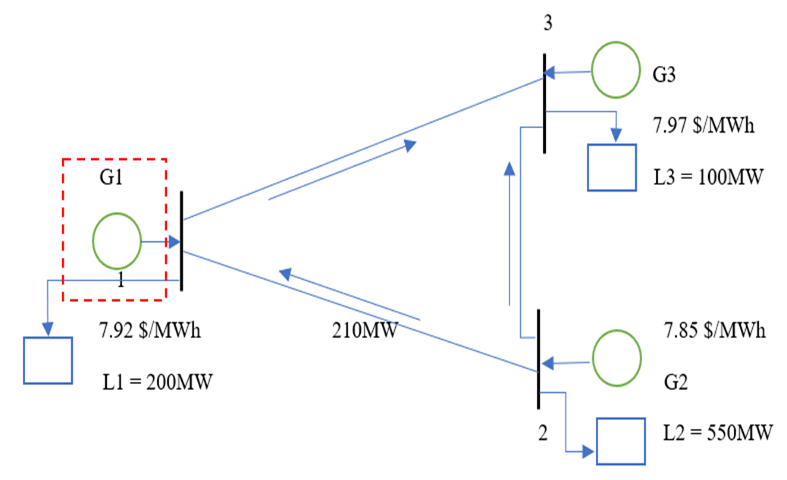
3-bus network: Bus 1 has no generator and the demand will be satisfied by generators 2 and 3
Generation cost
What is the value of adding a generator at bus 1?
What is the value of adding another transmission line from bus 2 to bus 1?
Transmission capacity
Load
8

Slide 9
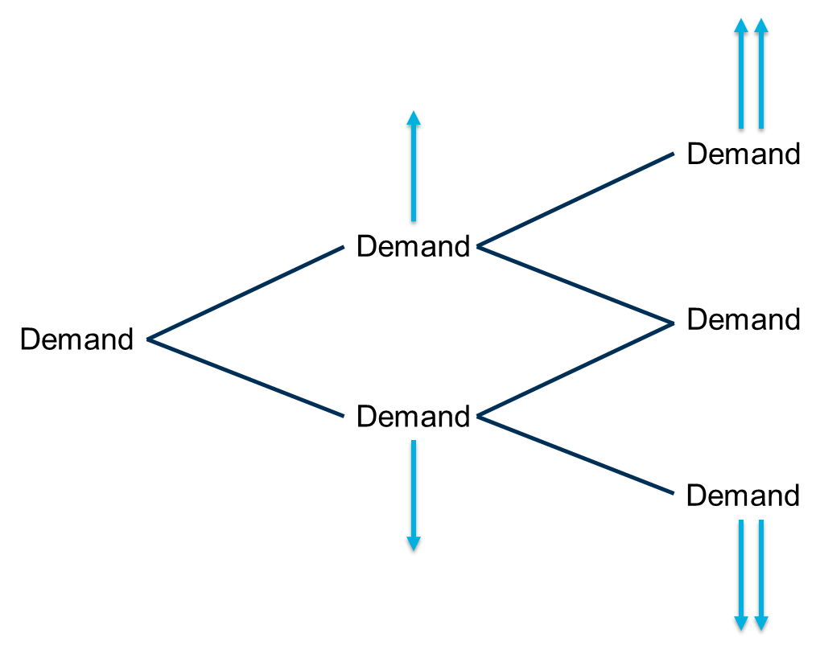
Demand at bus 1 follows geometric Brownian motion and can increase or decrease in each period (lattice)
Initial demand = 200 MW
Volatility = 30% per year
Risk-free discount rate = 5% annual
Time horizon = 5 periods
Up value = 1.35
Down value = 0.741
Risk-neutral probabilities
Probability of up = 0.51
Probability of down = 0.49

Slide 10
If a new generation unit at bus 1 costs $100,000 with a generation cost of $7.92 per MWh, the real option value is $620,000
Millions of $
Add
Hold
Hold

Slide 11
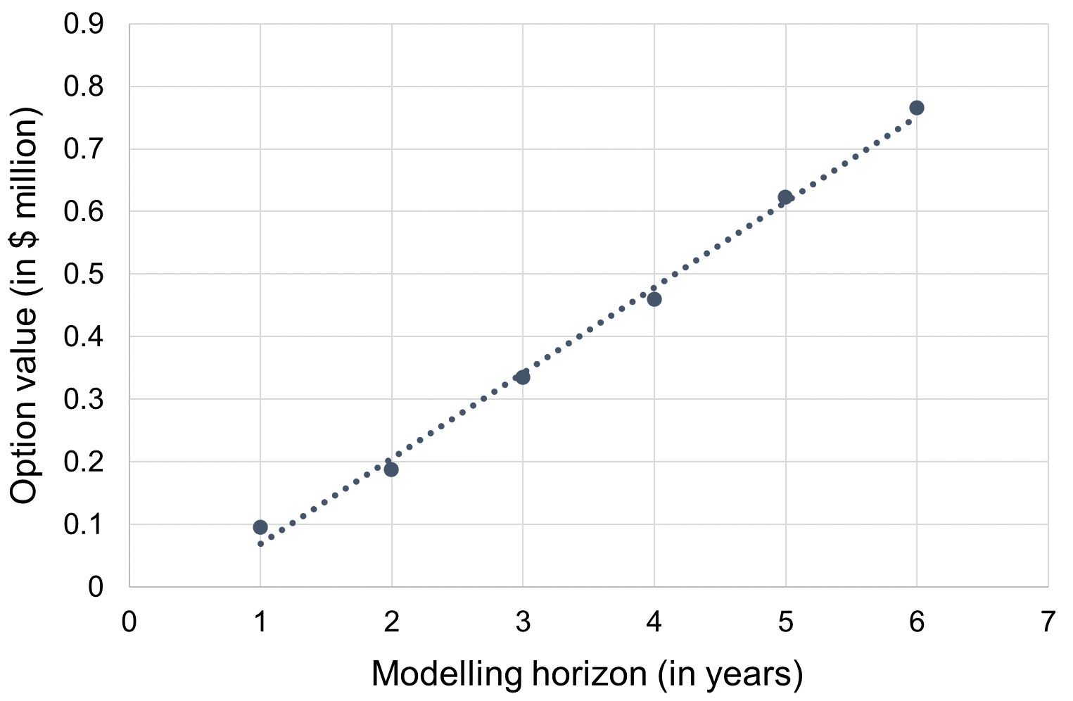
Option value increases with modelling horizon

Slide 12
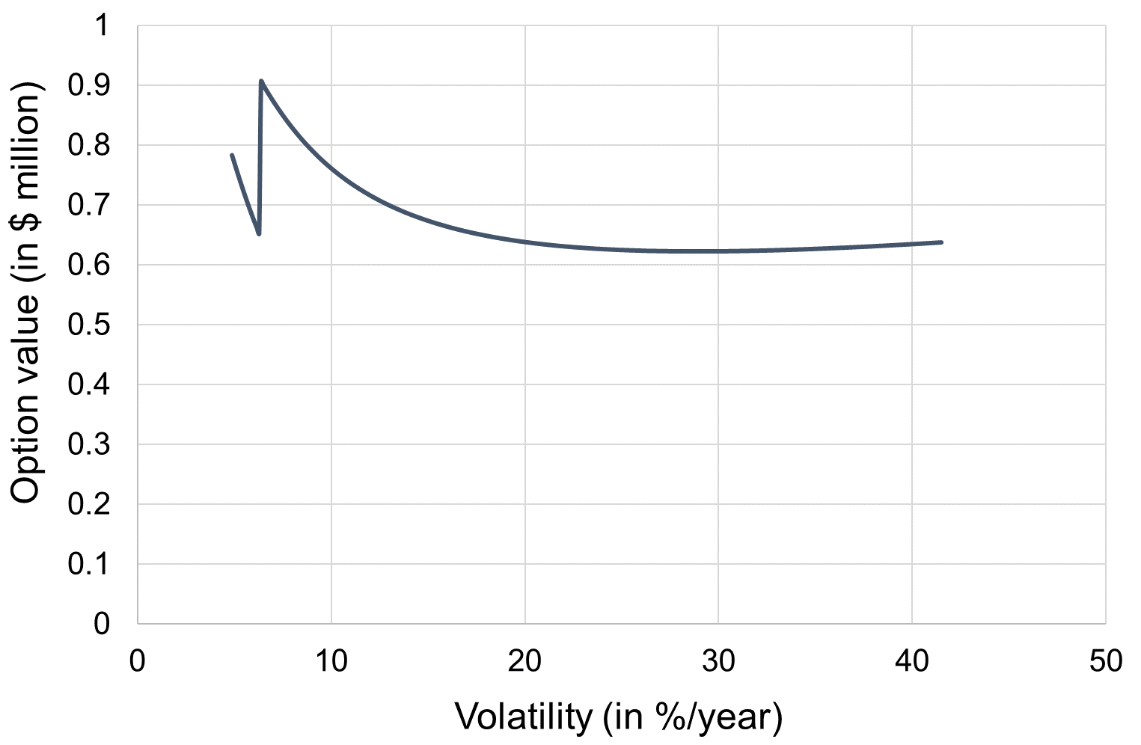
Option value is non-monotonic with respect to volatility

Slide 13
If a new transmission line with capacity of 105 MW from bus 2 to bus 1 costs $100,000, the real option value is $1.01 M
Millions of $
Add
Hold
Hold
13

Slide 14
Why is the option value for transmission more than the value for generation?
Generation cost
Optimal power flow calculations → location marginal price
105MW
Transmission capacity
Load
14

Slide 15
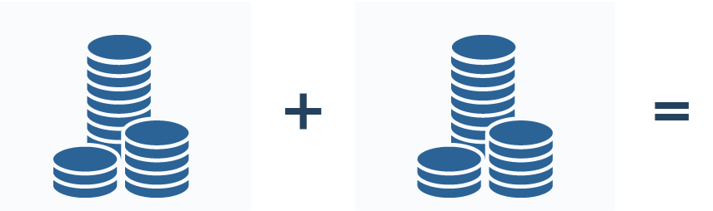
Real option value model assumes cost uncertainty can be hedged
Neutral exposure or reduced risk
Loss to initial position
Gain to hedge
What if cost uncertainty cannot be hedged or only partially hedged?

Slide 16
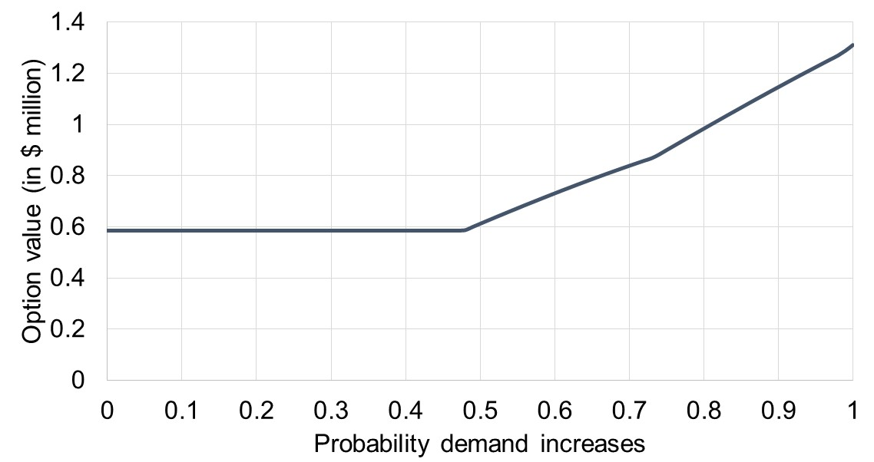
Value of option for new generation unit with no hedging
Install generation in period 1 if demand increases
Wait until period 2
Install generation immediately

Slide 17
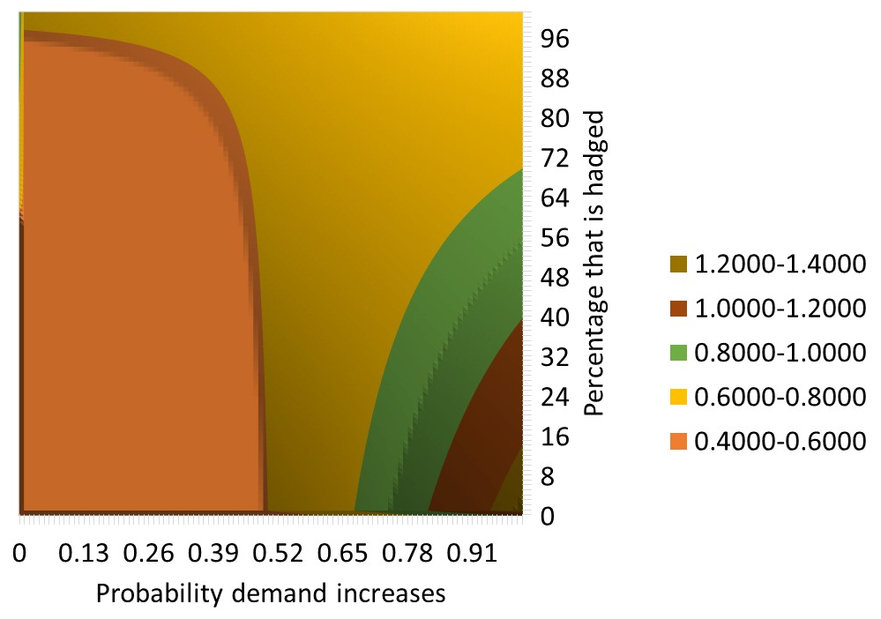
Value of option for new generation unit with partial hedging
Value of option (in $ million)

Slide 18
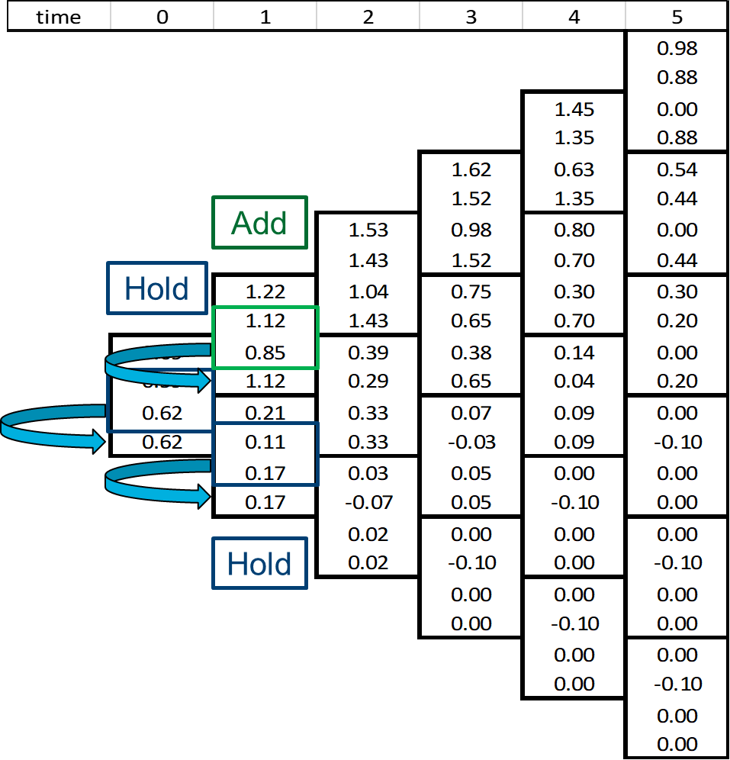
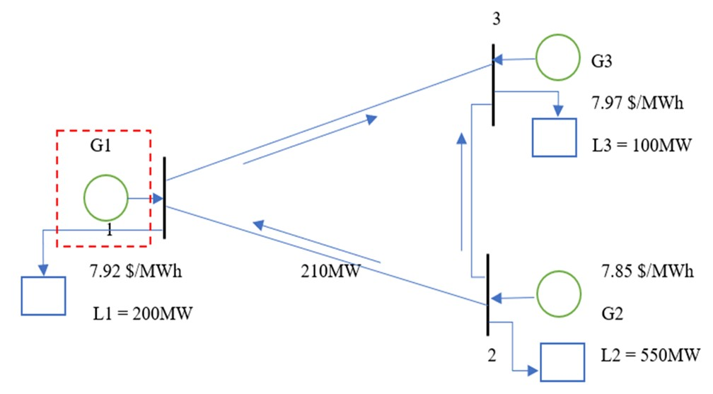
Real option theory with optimal power flow model can value new generation and transmission capability
$620,000 for new generation unit
$1.01M for new transmission line
Excel spreadsheets to enter your own calculations
www.imse.iastate.edu/sweeet

Slide 19
Q&A
Cameron MacKenzie, camacken@iastate.edu,
www.imse.iastate.edu/sweeet

