Slide 1
Designing Flexible Electric Generation Portfolios in Iowa
Xue Lei
Cameron MacKenzie
Kyung (Jo) Min
Ramin Giahi
Industrial and Manufacturing Systems Engineering,
Iowa State University, Ames, Iowa.

Slide 2
Introduction
Iowa Electric Profile (2020 - Including Non-Utility Generation)
ELECTRIC GENERATION IN IOWA BY PRIMARY ENERGY SOURCE | 2020 NAMEPLATE CAPACITY (MW) | PERCENT OF NAMEPLATE CAPACITY | 2020 GENERATION (MWH) | PERCENT OF GENERATION
Coal | 5,754.7 | 25.61% | 14,146,835 | 23.72%
Wind | 11,406.9 | 50.76% | 34,182,302 | 57.32%
Nuclear | 0.0 | 0.0% | 2,904,863 | 4.87%
Natural Gas | 4,215.0 | 18.76% | 7,036,824 | 11.80%
Hydro | 129.2 | 0.58% | 1,025,215 | 1.72%
Other & Other Renewables | 22.0 | 0.10% | 207,440 | 0.35%
Petroleum | 924.2 | 4.11% | 111,111 | 0.19%
Solar | 18.4 | 0.08% | 22,082 | 0.04%
Total | 22,470.4 | 100.00% | 59,636,672 | 100.00%
https://iub.iowa.gov/iowas-electric-profile
2

Slide 3
Introduction
Challenges in planning for the future:
Uncertainties
Demand
Costs (investment, fuel)
Requirements for using renewable sources
Future carbon emission limit
Need to make decisions at different stages
Flexible electric generation portfolio will provide a more reliable planning for the future
3

Slide 4
Problem description
Decision variables: Choose capacity for each electricity technology at each stage
Objective: Minimize total cost
Investment
Operations and maintenance
Cost of fuel generation
Salvage value
Constraints
Capacity greater than demand
Power flow equations
Requirement that X% comes from renewable resources
Limit on carbon emissions
Limit on natural gas
Uncertainties
D. Mejia-Giraldo and J. D. McCalley, “Maximizing future flexibility in electric generation portfolios,” IEEE Transactions on Power Systems, vol. 29, no. 1, pp. 279–288, 2014.
4

Slide 5
Related research
Electric generation planning with uncertainty Stochastic programming
Two-stage stochastic optimization
Multi-stage stochastic optimization
Large number of uncertain scenarios: scenario reduction methods
Limitations:
The number of required scenarios needs to be decided
The selected scenarios might ignore the valuable information from eliminated scenarios.
5

Slide 6
Methodology
Deep reinforcement learning
Provide the optimal generation planning for each simulated uncertain scenario using a learned neural network
The neural network is trained by the action and reward pairs
Myopic planning
Decision making that focuses on optimizing for the current period
Combine the Monte Carlo simulation with myopic planning to generate long-term planning for electric generation.
6

Slide 7
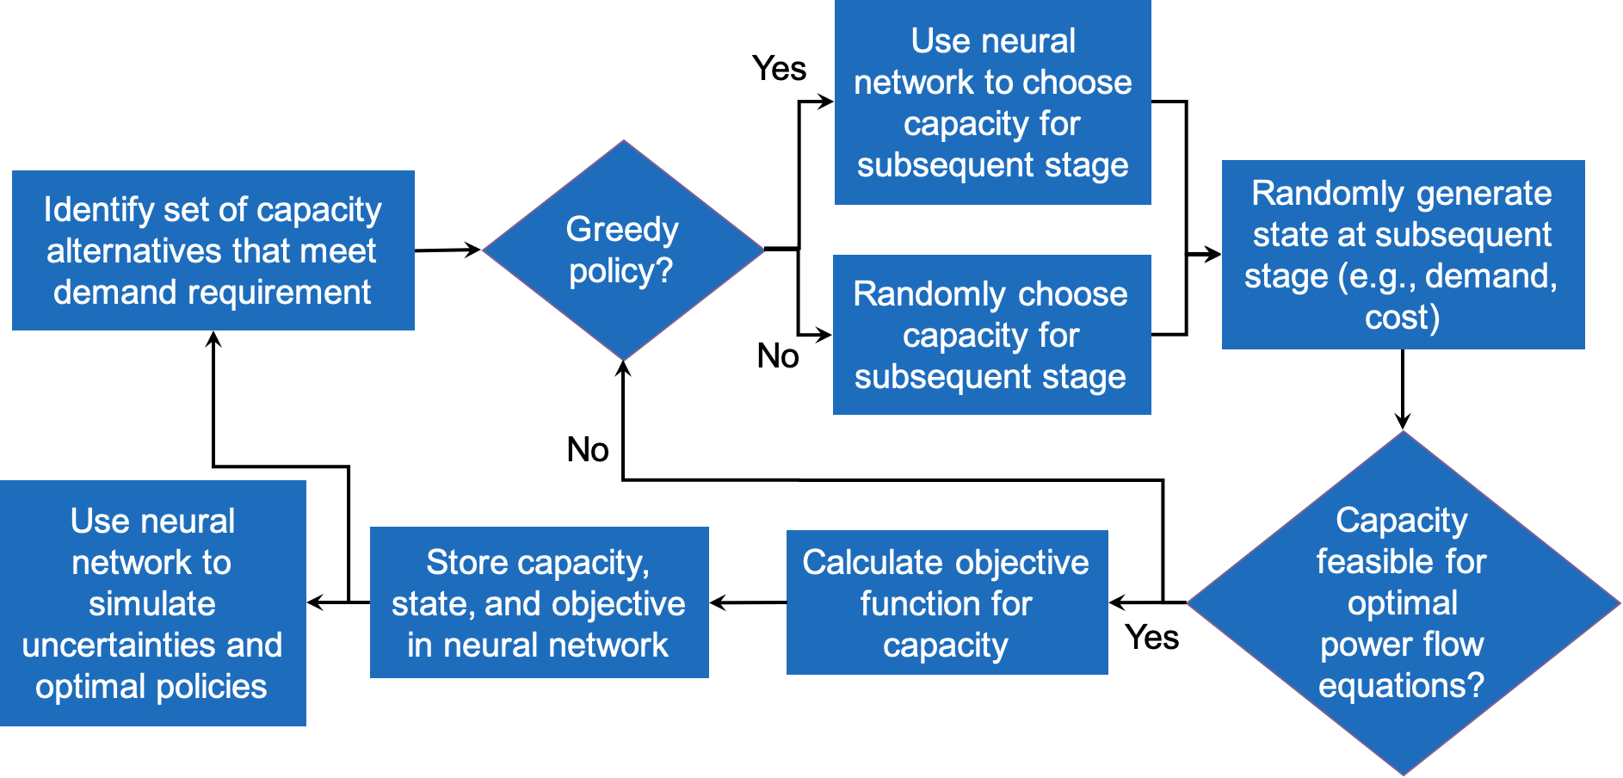
Deep-learning methodology
R. Giahi, 2020. “Sequential decision making and simulation-optimization for the design of complex engineering systems.” PhD Dissertation, Iowa State University. https://lib.dr.iastate.edu/etd/18317/
7

Slide 8
Application
Planning horizon = 10 years = 5 periods
Each period consists of 3 demand profiles
Uncertainties:
investment in wind power
demand for each time period
renewable power source percentage
carbon emission limit
For each uncertain parameter, 2 potential change rates are considered
Assume that the fuel-based technology using coal and natural gas will need to retire in the next 10 years
8

Slide 9
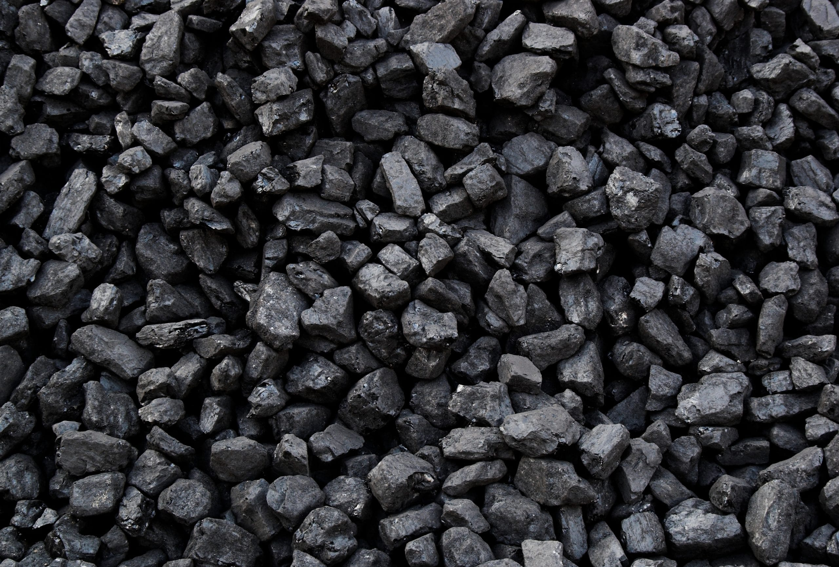
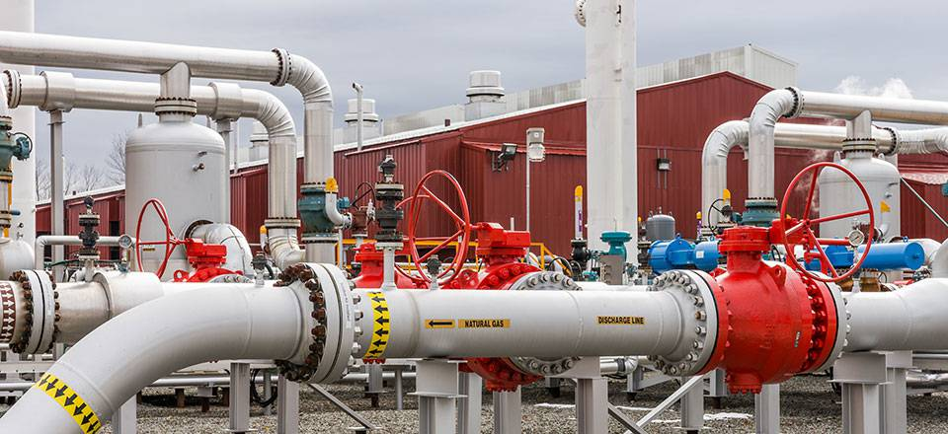
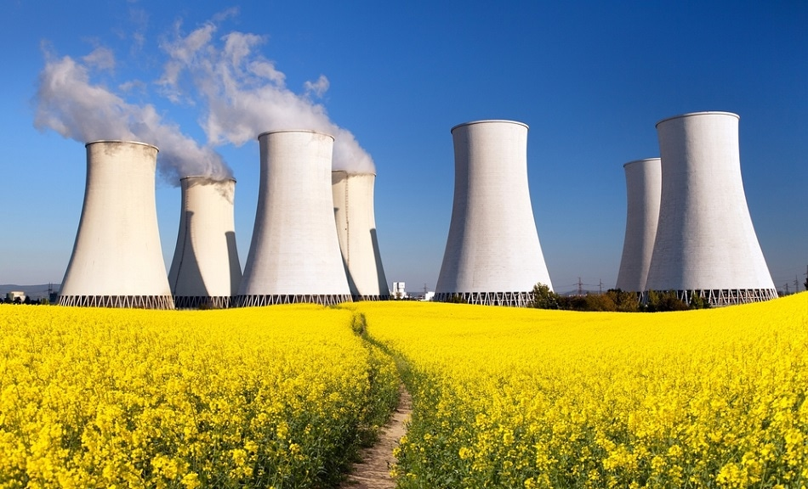
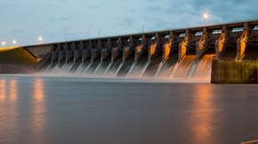
Alternatives for electricity generation
9

Slide 10
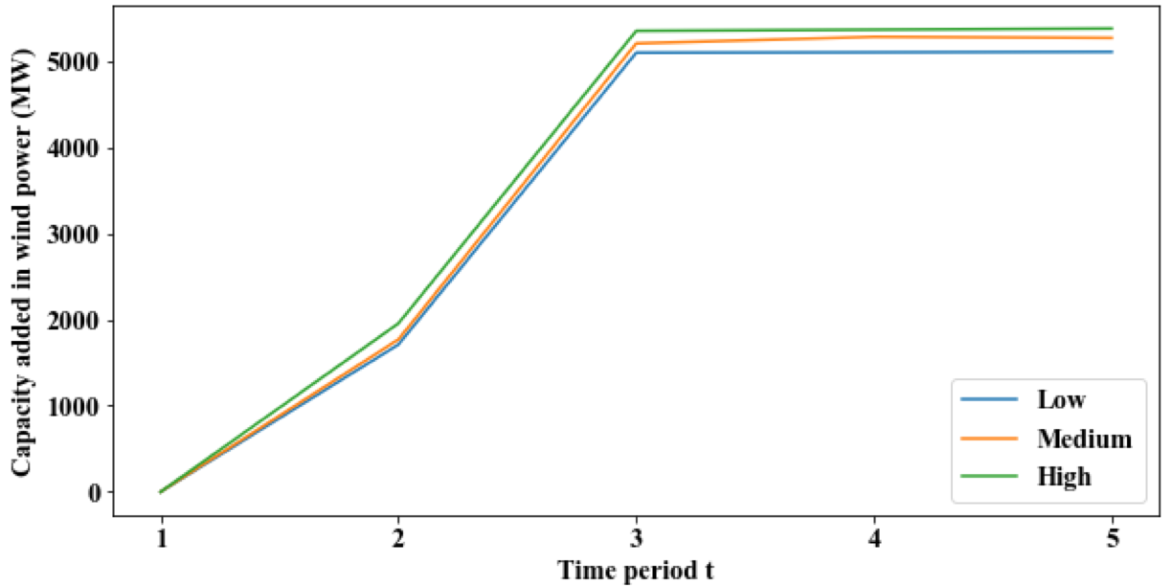
Myopic planning results for the state of Iowa
10

Slide 11
Preliminary conclusions
Wind energy is most cost-effective solution in Iowa for new generation sources
Neural network in deep reinforcement learning (PyTorch)
Did not produce accurate results in a reasonable amount of time
Potential fixes
Adjust parameters in neutral network
Additional GPUs
Adjust algorithm to sample more intelligently
11

Slide 12
Future work
More research needs understand the conditions when reinforcement learning provides more accurate results than myopic planning
Include additional energy sources such as solar power and petroleum
Additional complexity (e.g., time to install new generation)
Additional constraints to reflect policy goals for renewable resources
Acknowledgements
Iowa Energy Center (Solar and Wind Energy using Engineering Economics Theory, SWEEET, https://www.imse.iastate.edu/sweeet )
Diego Mejia-Giraldo for providing data file from his original study
12

Slide 13
Q&A
Xue Lei, xlei@iastate.edu

