Slide 1
Valuation of a generator option to a community
Gazi Nazia Nur

Slide 2

Aim
Valuation of a generator option
  Adding a generator to the network is a real option
Understanding what real option is
  A real option gives a firm's management the right (permit) but not the obligation to undertake certain business opportunities or investments

Slide 3
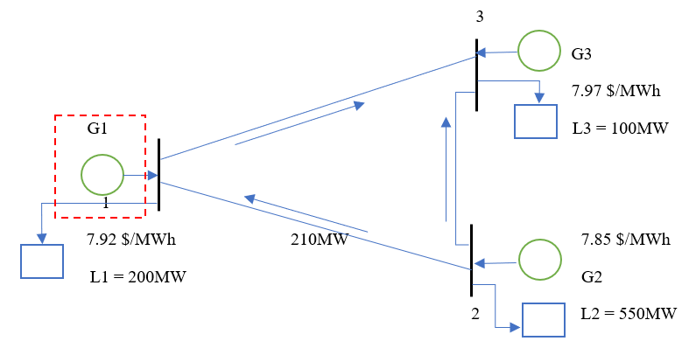
Background
Case 1: Bus 1 will have no generator and the demand at this node will be satisfied by generators 2 and/or 3
Case 2: We will add a generator at bus 1 and the total demand will be met by the combination of all three generators

Slide 4
Background
For bus 1 community if the line constraint (210 MW) is violated
  LMP for case 1 is $8.045/MWh ← Generator not present at bus 1
  LMP for case 2 is $7.92/MWh ← A generator is present at bus 1
Otherwise LMP is $7.85/MWh for both cases
Objective: Evaluating the option value of adding a generator

Slide 5
Introduction
Our option is adding a generator to the network at bus 1
This option valuation is done from the perspective of bus 1 community
To evaluate the option value of adding a generator, we first need to know how electricity demand at bus 1 evolves with time
We assume electricity demand follows geometric Brownian motion (gBm)
To map out demand using demand lattice
Notes:
A geometric Brownian motion (GBM) (also known as exponential Brownian motion) is a continuous-time stochastic process in which the logarithm of the randomly varying quantity follows a Brownian motion (also called a Wiener process) with drift.
Brownian motion is the random motion of particles suspended in a medium (a liquid or a gas)
stochastic drift is the change of the average value of a stochastic (random) process

Slide 6
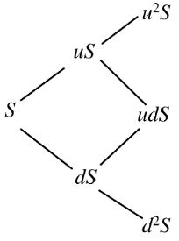
Demand lattice
Demand lattice is a binomial lattice
A binomial lattice is an essential tool to map the evolution of a random variable with time
Demand lattice displays the future probable demand of all time-period in a simple manner
Binomial lattice

Slide 7
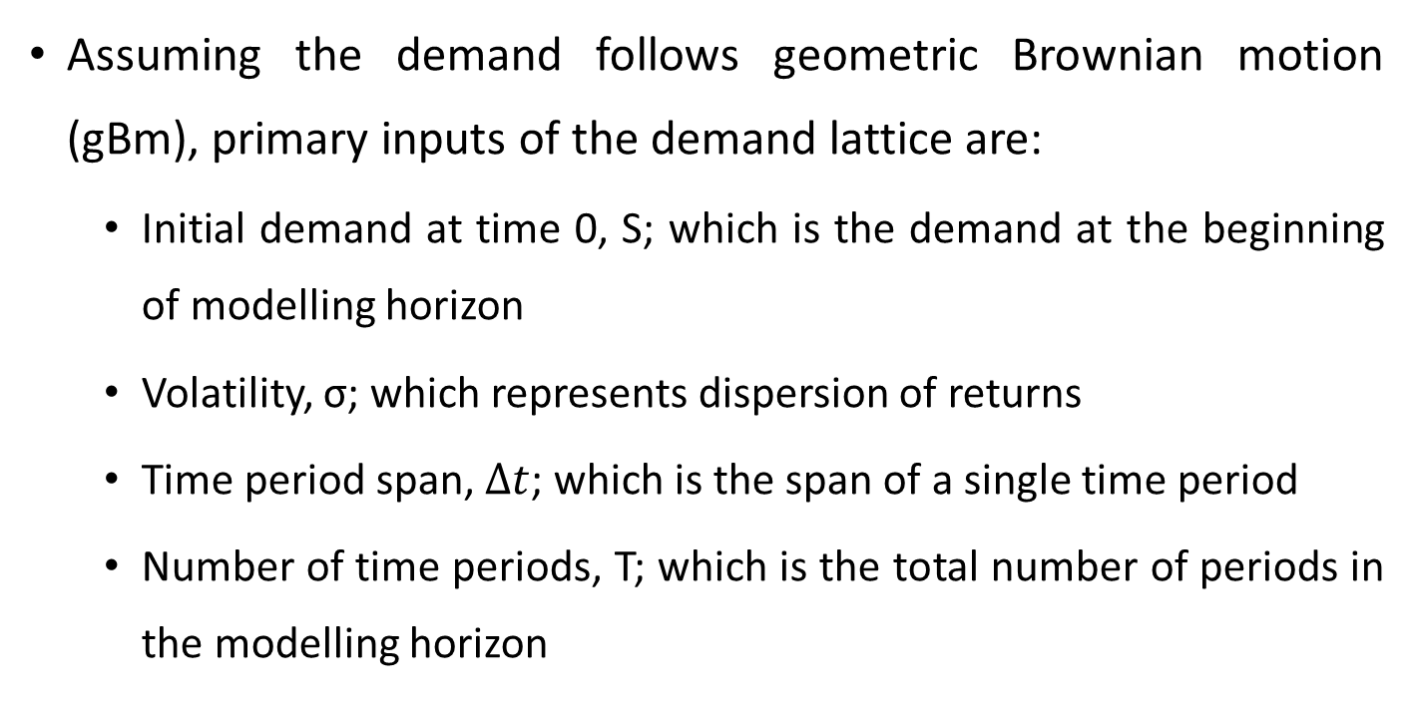
Input of demand lattice
Assuming the demand follows geometric Brownian motion (gBm), primary inputs of the demand lattice are:
  Initial demand at time 0, S; which is the demand at the beginning of modelling horizon
  Volatility, σ; which represents dispersion of returns
  Time period span, $Δt$; which is the span of a single time period
  Number of time periods, T; which is the total number of periods in the modelling horizon
Demand lattice

Slide 8
Input of demand lattice
From Initial demand at time 0, S, volatility, σ, and time period span, $Δt$, the values of U and D are calculated
Up value, U is the multiplier when demand goes up and down value, D is the multiplier when demand goes down
U and D can be calculated using following formulae:
$U= e^{\text{σ} × \sqrt{Δt} }$
$$D= \frac{1}{U}$$

Slide 9
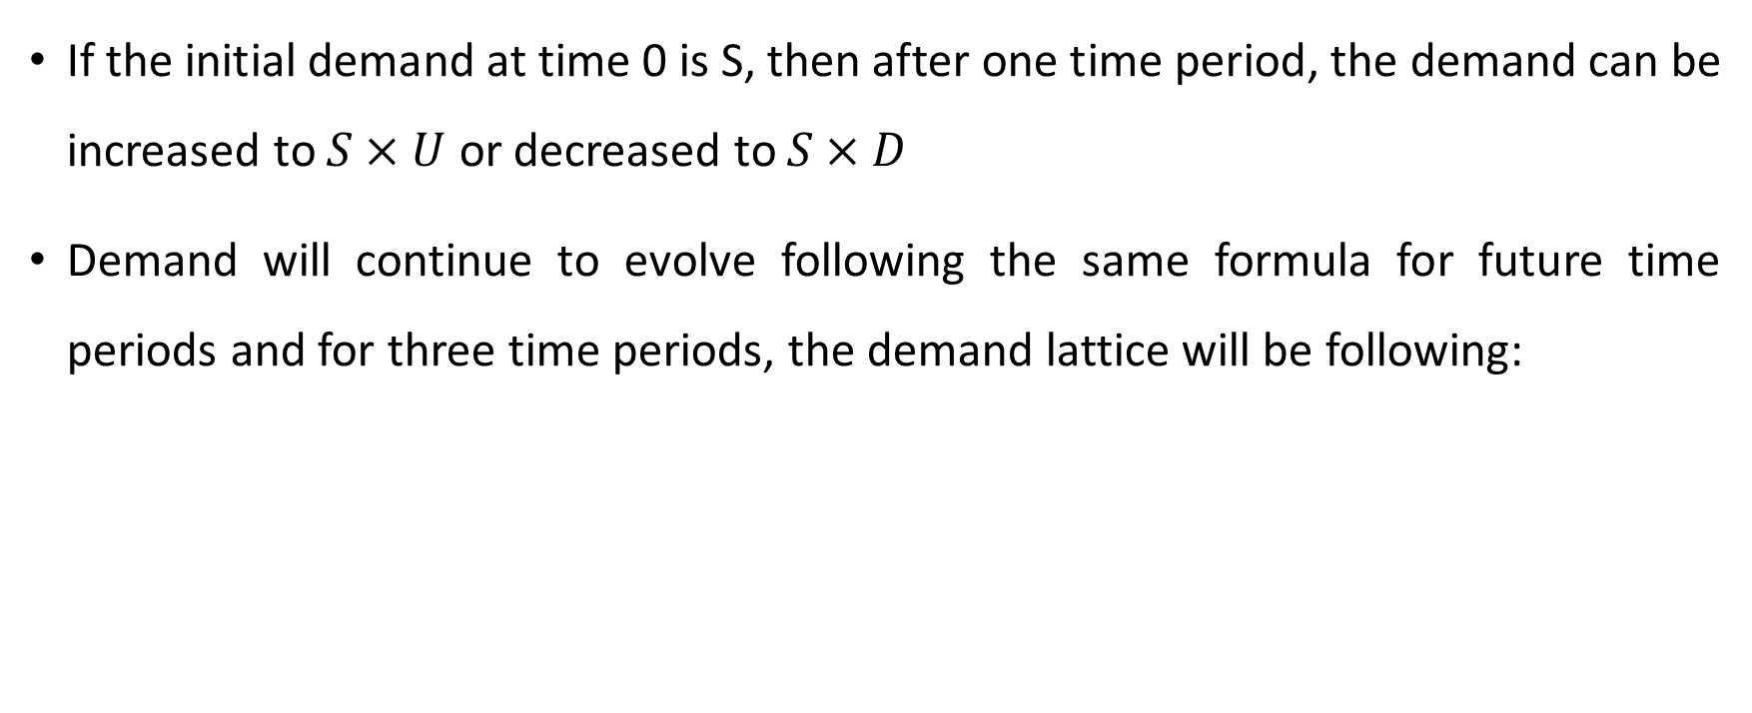
Output (demand lattice)
If the initial demand at time 0 is S, then after one time period, the demand can be increased to $S×U$ or decreased to $S×D$
Demand will continue to evolve following the same formula for future time periods and for three time periods, the demand lattice will be following:
3 time-period
demand lattice

Slide 10

Input and output of demand lattice
Initial demand at time 0, S = 200 MW
Volatility, σ = 30%/year
Time-period span, Δ𝑡 = 1 year
Number of time periods, T = 3
Up value, $U= e^{\text{σ} × \sqrt{Δt} }$= 1.35
Down value, $D= \frac{1}{U}$ = 0.7408

Slide 11
Option valuation
In our example, the option is adding a generator to the network
We are assuming:
  The option is a European call option for simplicity; European-style options may be exercised only at expiration
  The option can be exercised at expiration after knowing the demand at that time period

Slide 12
Option valuation
Option value is calculated from option value tree
To solve the problem, we are considering two cases
  Case 1: A generator is not added to bus 1
  Case 2: A generator is added to bus 1

Slide 13
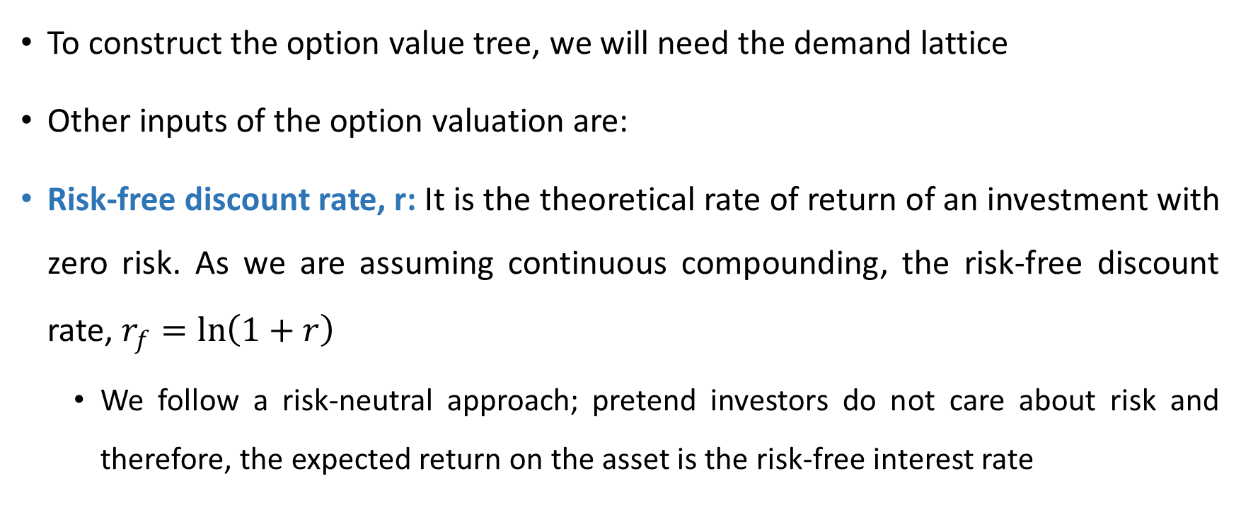
Input of option valuation
To construct the option value tree, we will need the demand lattice
Other inputs of the option valuation are:
Risk-free discount rate, r: It is the theoretical rate of return of an investment with zero risk. As we are assuming continuous compounding, the risk-free discount rate, $r_{f}=\ln\left(1+r\right)$
  We follow a risk-neutral approach; pretend investors do not care about risk and therefore, the expected return on the asset is the risk-free interest rate

Slide 14
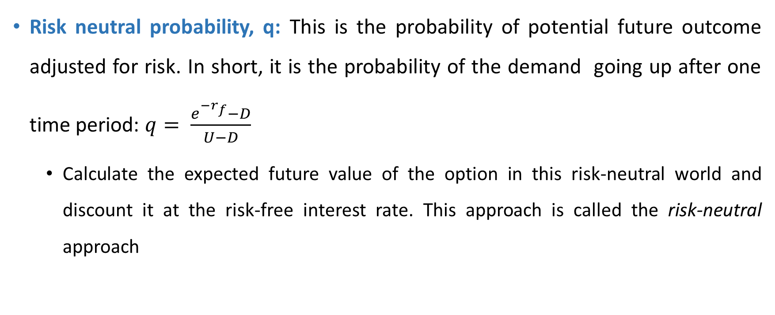
Input of option valuation
Risk neutral probability, q: This is the probability of potential future outcome adjusted for risk. In short, it is the probability of the demand going up after one time period: $q= \frac{e^{−r_{f}}−D}{U−D}$
  Calculate the expected future value of the option in this risk-neutral world and discount it at the risk-free interest rate. This approach is called the risk-neutral approach

Slide 15
Input of option valuation
  The benefit of this risk-neutral pricing approach is that once the risk-neutral probabilities are calculated, they can be used to price every asset based on its expected payoff
  If real-world probabilities were used, the expected values of each security would need to be adjusted for its individual risk profile
Exercise price, K: For our example, it is the construction price of the generator

Slide 16
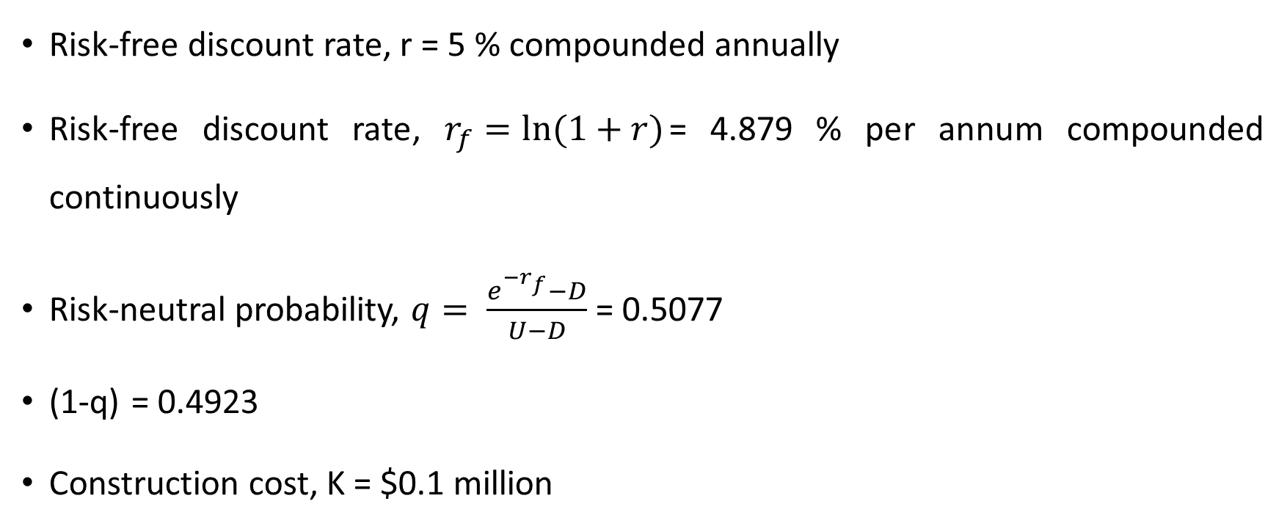
Input of option valuation
Risk-free discount rate, r = 5 % compounded annually
Risk-free discount rate, $r_{f}=ln⁡(1+r)$= 4.879 % per annum compounded continuously
Risk-neutral probability, $q= \frac{e^{−r_{f}}−D}{U−D}$ = 0.5077
(1-q) = 0.4923
Construction cost, K = $0.1 million

Slide 17
Process of option valuation
To start with option valuation, we need the demand lattice
Initially demand is 200 MW
The probability of demand going up after one time period and be 269.97 MW is q and the probability of demand going down to 148.16 MW is (1-q)
q
q
q
1-q
1-q
1-q
1-q
Demand lattice

Slide 18
Process of option valuation
  The process of calculating the option value is:
  Step 1- Determining locational marginal prices (LMP): The first step is determining LMPs at bus 1 separately for each demand of the demand lattice for both case 1 and 2
Demand = 269.97 MW
Demand = 200 MW
Demand = 148.16 MW

Slide 19
Process of option valuation
  When demand is 269.97 MW, LMP for case 2 is $7.92 MWh. But, to fulfil 200 MW/ 148.16 MW electricity demand, LMP is $7.85 MWh
Demand = 269.97 MW
Demand = 200 MW
Demand = 148.16 MW

Slide 20
Process of option valuation
  Step 2- Calculating the cost: The next step is to calculate the cost paid by the community at bus 1 to fulfil their electricity demand for both cases using the following formula:
  Cost paid by the community Yearly = Demand at that time period x LMP to fulfil the demand x 8760
  Here, 8760 is the number of hours in a year
269.97 x 8.045 x 8760 x 10^-6
200 x 7.85 x 8760 x 10^-6
148.16 x 7.85 x 8760 x 10^-6

Slide 21
Process of option valuation
  If the line constraint (210 MW) is violated to fulfil the demand, then the LMP at bus 1 for that demand is $7.92/MWh. Otherwise, LMP is $7.85/MWh
269.97 x 7.92 x 8760 x 10^-6
200 x 7.85 x 8760 x 10^-6
148.16 x 7.85 x 8760 x 10^-6

Slide 22
Process of option valuation
Step 3- Calculating the net benefit: The net benefit of adding a generator to bus 1 is calculated by subtracting the cost for case 2 from cost for case 1
19.0260 - 18.7304
13.7532 – 13.7532
10.1886 – 10.1886

Slide 23
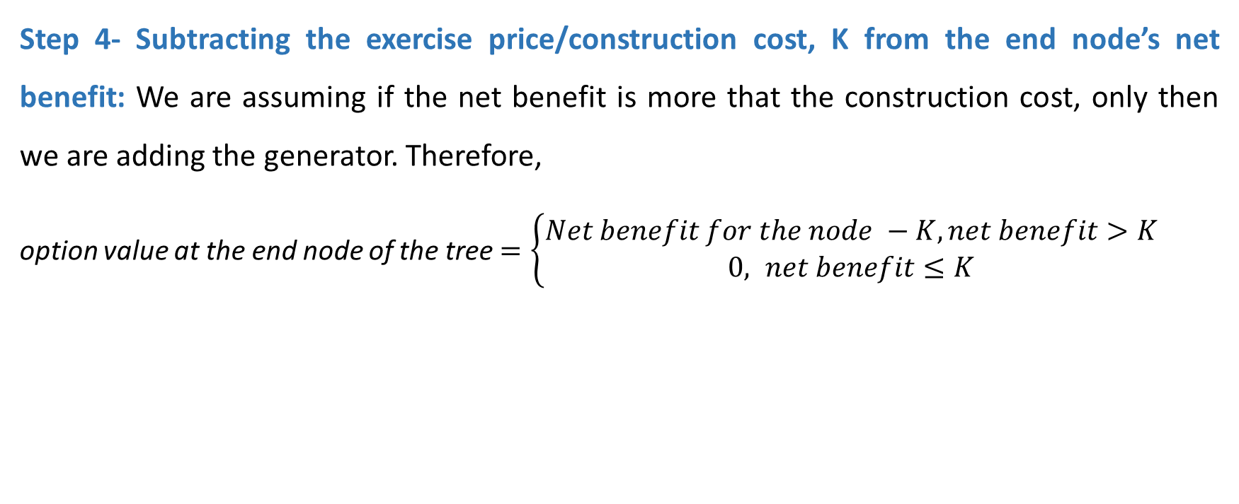
Process of option valuation
Step 4- Subtracting the exercise price/construction cost, K from the end node’s net benefit: We are assuming if the net benefit is more that the construction cost, only then we are adding the generator. Therefore,
option value at the end node of the tree$=\left\{\begin{aligned}Net benefit for the node −K,net benefit>K \\ &0, net benefit≤K\end{aligned}\right.$
0.5387 – 0.1
0.2956 – 0.1
Net benefit 0

Slide 24
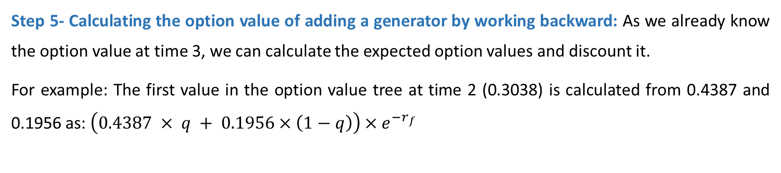
Process of option valuation
Step 5- Calculating the option value of adding a generator by working backward: As we already know the option value at time 3, we can calculate the expected option values and discount it.
For example: The first value in the option value tree at time 2 (0.3038) is calculated from 0.4387 and 0.1956 as: $\left(0.4387 × q + 0.1956×\left(1−q\right)\right)×e^{−r_{f}}$

Slide 25
Option value (output of valuation process)
The option value of a adding a generator is $0.1139 million

Slide 26
Conclusion
The example we demonstrated here is a European call option; that means the generator can be added only at expiration
We also have example with American call option where generator can be added any time before expiration
For large problems, the valuation process of American call options is computationally taxing
For an American call option, option value can increase substantially

