Slide 1
Valuation of a generator option to a community-
Computing with Excel
Gazi Nazia Nur

Slide 2
Download the Excel file
Go to: https://www.imse.iastate.edu/sweeet/

Slide 3
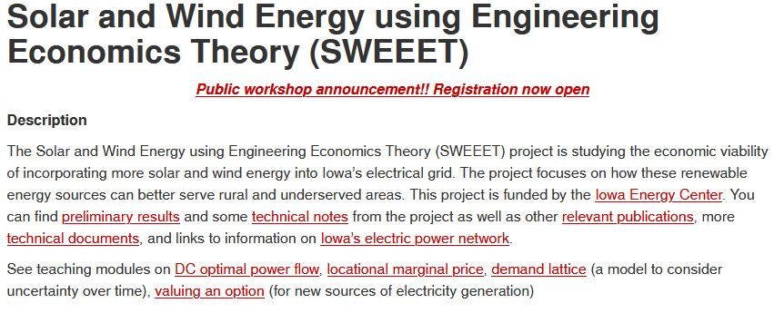
Download the Excel file
Click on “valuing an option” as shown below:
Click on this

Slide 4
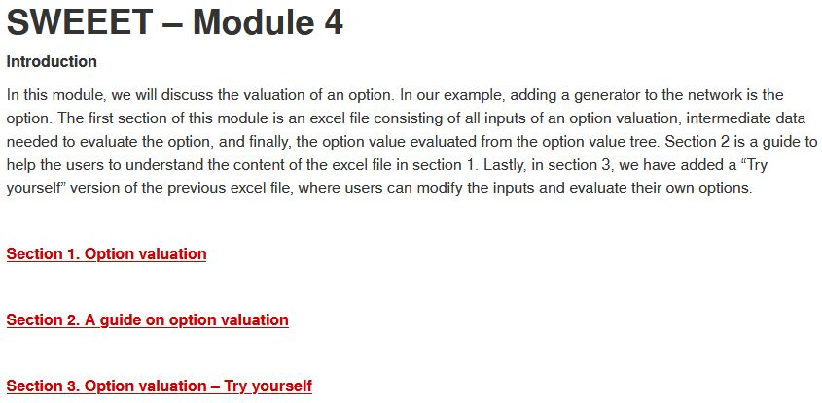
Download the Excel file
Click on “Section 3. Option valuation – Try yourself” as shown below to download:
Click on this to download

Slide 5
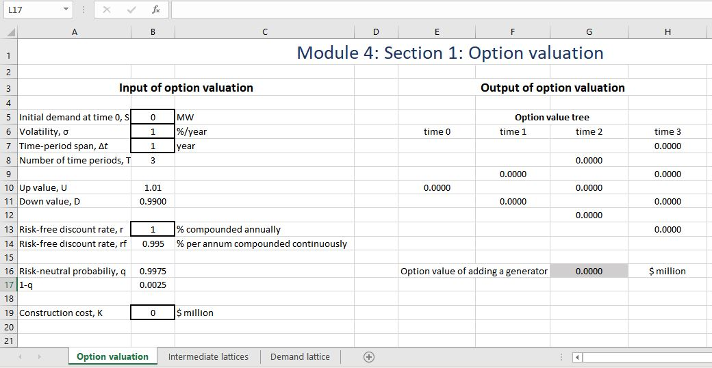
Excel file

Slide 6
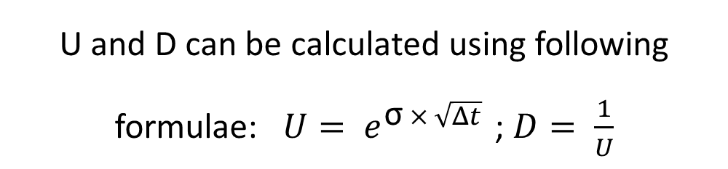
Input of demand lattice (“Option valuation” sheet)
Changeable parameters
U and D can be calculated using following formulae: $U= e^{\text{σ} × \sqrt{Δt} }$; $D= \frac{1}{U}$

Slide 7

Output of demand lattice (“Demand lattice” sheet)
On the sheet titled “Demand lattice” we will find the output of demand lattice
If the initial demand at time 0 is S, then after one time period, the demand can be increased to $S×U$ or decreased to $S×D$

Slide 8
Demand lattice (“Demand lattice” sheet)

Slide 9
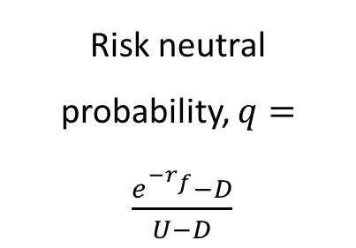
Input of option valuation (“Option valuation” sheet)
Risk neutral probability, $q= \frac{e^{−r_{f}}−D}{U−D}$
Additional input for option valuation

Slide 10
Output (“Option valuation” sheet)
On the right side of the excel sheet “Option valuation”, a option value tree for three time period is constructed and the option value is calculated

Slide 11
“Intermediate lattices” sheet
  Lattices in the “Intermediate lattices” sheet are:
    LMP lattices for case 1 and 2 which are dependent on demand values from demand lattice
    Cost lattices for case 1 and 2 which are calculated as: Cost paid by the community Yearly = Demand at that time period x LMP to fulfil the demand x 8760
    Net benefit lattice, which is calculated by subtracting cost (case 2) from cost (case 1)

Slide 12
Let’s try ourselves…
You can change the input parameters in “black borders” to match your own example
For example: If we change the discount rate, option value will change

Slide 13
Let’s try ourselves…
If we change the value of r to 10% compounded annually, then the option value tree looks like:

Slide 14
Conclusion
Option value increases as discount rate increases; Because, as discount rate increases, risk neutral probability increases too. As a result, expected benefit increases and ultimately, option value increases
The example we demonstrated here consists a European call option and generator can be added only at expiration
We also have example with American call option where generator can be added any time before expiration

Slide 15


