Slide 1
Excel Solver - Instructions
Jay Ghodke
Dr. K. Jo Min

Slide 2
Excel Solver – How to download
Go to the website - https://www.imse.iastate.edu/sweeet/
Select – DC Optimal Power Flow
Scroll down to the last and click on - 1c. Download Excel for experimentation and other purposes
An Excel file will be downloaded with the DCOPF template already put in
Notes:
Page fades in, red pops up. Only this page

Slide 3
Excel Solver – How to install
In Excel 2010 and later, go to File > Options
Note: For Excel 2007, click the Microsoft Office Button Office button image , and then click Excel Options
Click Add-Ins, and then in the Manage box, select Excel Add-ins. Click Go
In the Add-Ins available box, select the Solver Add-in check box, and then click OK
Notes:
If the Solver Add-in is not listed in the Add-Ins available box, click Browse to locate the add-in.
If you get prompted that the Solver Add-in is not currently installed on your computer, click Yes to install it.
After you load the Solver Add-in, the Solver command is available in the Analysis group on the Data tab.
Notes:
Page fades in, red pops up. Only this page

Slide 4
Excel Solver – Input
Step 1 – Write down the variables in one column and values in the next column. Let the values be 0 initially. Similarly input the values of Pload which are already given.
Step 2 – Write the objective function which is to minimize the cost. The objective function is the total cost cell in the excel file.
Step 3 – The constraints are already included the excel sheet. The lower bound and upper bound for theta should be kept as -3.14 to 3.14 radians. The lower bound of generation capacity is 0 and there is no upper bound given. The susceptance matrix has all the values needed for power flow calculations. The power flow limit in line 1-2 is also included with respective reactance.
Notes:
Page fades in, red pops up. Only this page

Slide 5
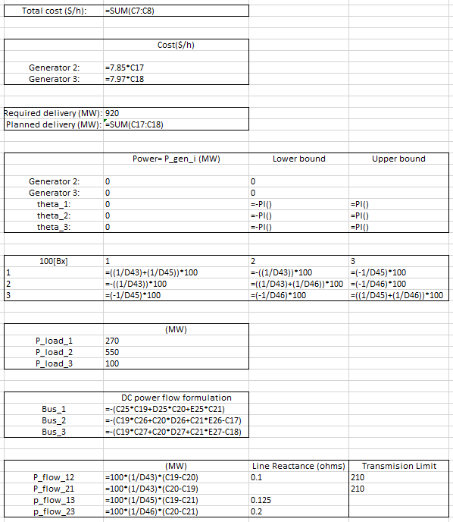
Excel – Variables and Constraints
Decision Variables
Susceptance Matrix
Power Flow Equation
Notes:
Page fades in, red pops up. Only this page

Slide 6
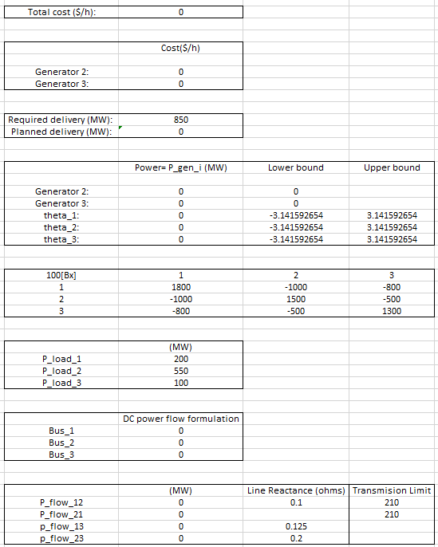
Excel Input – Case 1 (Scenario 1)
Input Parameters and Values –
Total load - 850
Demand load at bus 1 – 200 MW
Line reactance -
Transmission limit – 210 MW at line 1-2
Notes:
Page fades in, red pops up. Only this page

Slide 7
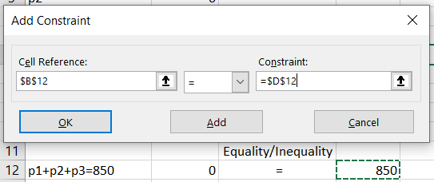
Excel Solver – How to add Constraints
Select Data (from top bar) > Solver. (Top right corner)
Step 1 - Set Objective – Select the cell where objective function has been written down.
Step 2 - To: Min
Step 3 - By changing variable cells: Select the whole column containing values of the variables p1, p2, p3, θ1, θ2 and θ3
Step 4 - Subject to constraints: select Add
Step 5 - Do not select the option – Make unconstrained variables non-negative
Step 6 - Select a solving method = GRG nonlinear or Simplex LP depending upon the objective function
Step 7 - Select Solve
Notes:
Page fades in, red pops up. Only this page

Slide 8
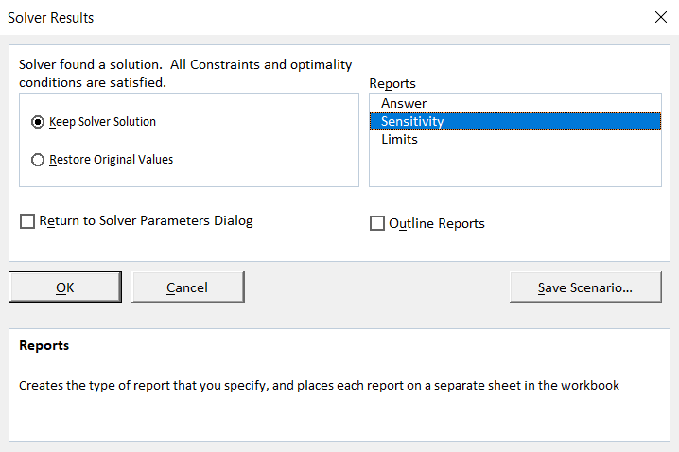
Excel Solver – Sensitivity Report
Continuing from step 7, now –
Step 8 – This window will pop-up after selecting solve. Select “Sensitivity” in Reports section and click OK to view the sensitivity report.
The sensitivity report given by the solver shows us all the values of decision variables as well as constraints. It also shows the value of Lagrange multiplier which is the LMP in our case. This Lagrangian multiplier is a dual variable.
Notes:
Page fades in, red pops up. Only this page

Slide 9
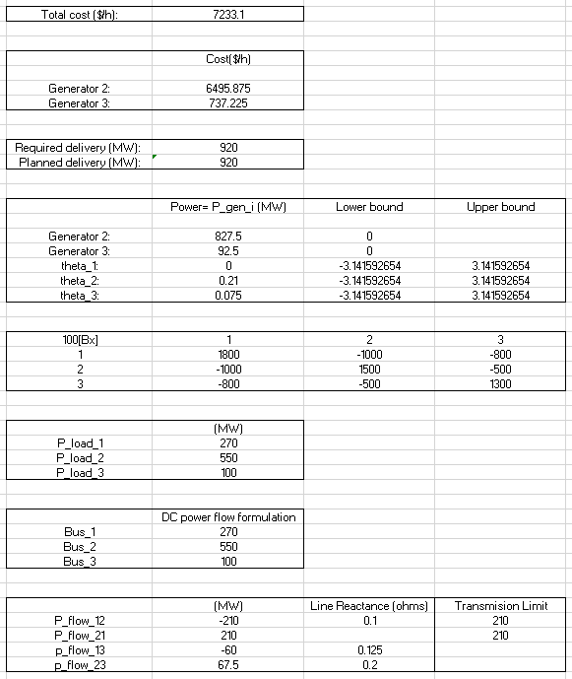
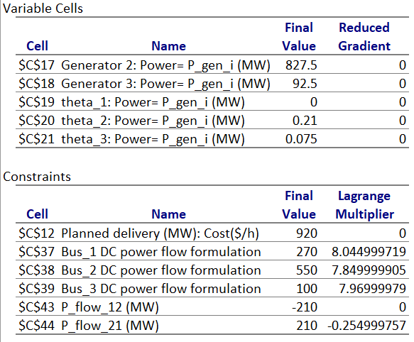
Excel Solver – Output
Sensitivity Report -
Notes:
Page fades in, red pops up. Only this page

Slide 10
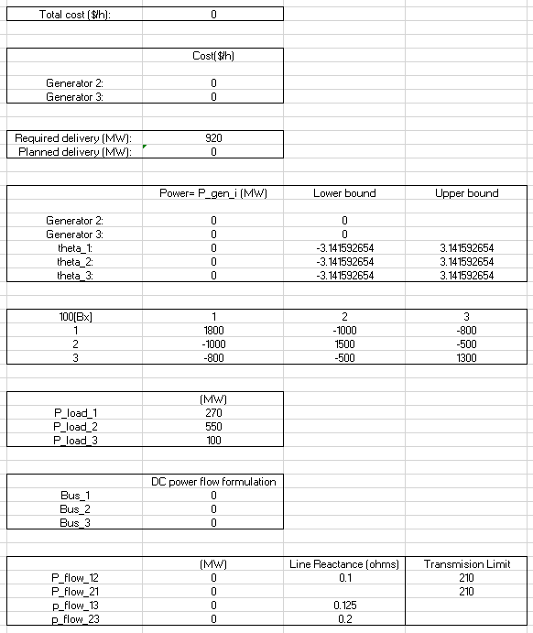
Excel Solver – Case 1 (Scenario 2)
Input Parameters and Values –
Total load – 850 and 920 MW
Demand load at bus 1 – 200 and 270 MW
Line reactance -
Transmission limit – 210 MW at line 1-2
Notes:
Page fades in, red pops up. Only this page

Slide 11
Excel Solver – Case 1 (Scenario 2)
Output – Sensitivity Report
Notes:
Page fades in, red pops up. Only this page

Slide 12
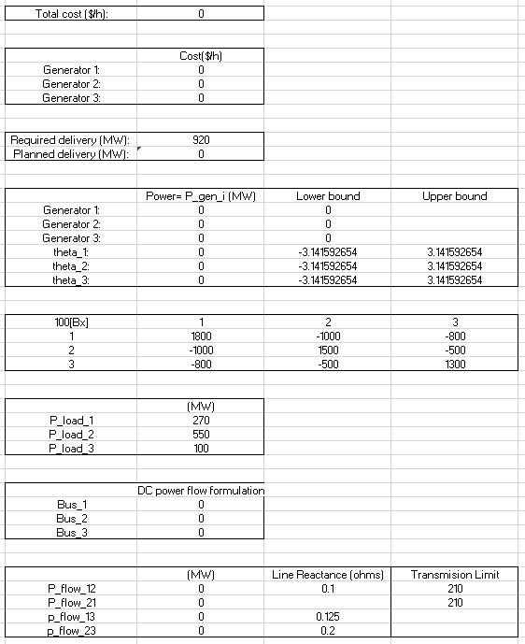
Excel Solver – Case 2 (Scenario 3)
Input Parameters and Values –
Total load – 920 MW
Demand load at bus 1 – 270 MW
Line reactance -
Transmission limit – 210 MW at line 1-2
Notes:
Page fades in, red pops up. Only this page

Slide 13
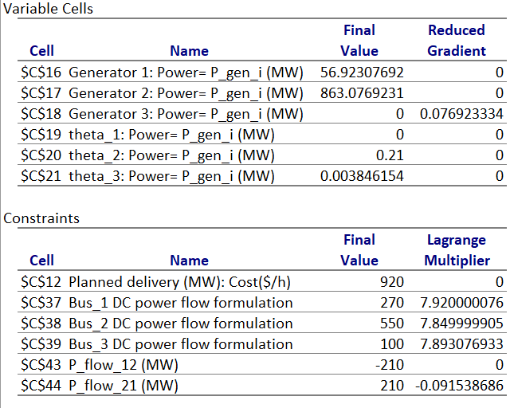
Excel Solver – Case 1 (Scenario 2)
Output – Sensitivity Report
Notes:
Page fades in, red pops up. Only this page

