Slide 1
Risk management for electric power planning
Cameron MacKenzie, Assistant Professor IMSE
SWEEET Public Workshop
August 11, 2021

Slide 2
Risks
Fire and explosion hazards
Safety risks
Distributed power generation
Market changes
Industrial Internet of Things
Cyber attacks
Regulatory changes
Natural hazards and global warming
Supply chain and business continuity risks

Slide 3
People problem
Corporate leaders to make safety part of their value structure by initiating and driving a culture of safety throughout the organization.
Engineers to apply inherently safe design principles.
Maintenance engineers to verify isolations while reliability engineers maintain asset uptime.
Operators to start up, shut down and respond to abnormal conditions.
Procurers, suppliers and transporters to understand their contribution to delivering and managing quality spare parts, materials and services that prevent the loss of containment

Slide 4
What can be done?
Electrical supply and reliability
Electrical safety and training
Business continuity planning
Fire protection engineering
Natural hazards engineering
Smart factories
Accurate property values
Insurance

Slide 5
When planners in an electric power company need to add new generating capacity, they may consider building a plant that burns coal or natural gas. After all, such fossil fuel–fired facilities are relatively inexpensive and should run for 40 years or more. But if future policies impose strict limits on carbon emissions, they might need to shut down their fossil fuel plants and build non-carbon systems such as solar or wind in a hurry—two extremely expensive propositions. On the other hand, if they build the more expensive non-carbon systems now and emissions policies aren’t enacted, they may have spent that extra money unnecessarily. Deciding to build fossil plants or choosing to invest in non-carbon generation—either decision has economic risk, given the uncertainty about long-term emissions policy.

Slide 6
On that basis, we believe there is a strong case for utilities to start now to take steps on climate-change adaptation. And there are ways for them to do so—for example by strengthening the grid, exploring investments in batteries and microgrids, and working with new partners.

Slide 7
Risks
Global warming and climate change
Rapidly changing industry
Cyber threats
Regulation and public policy
Tariffs and trade tension
Talent retention and new hires
Catastrophic events

Slide 8
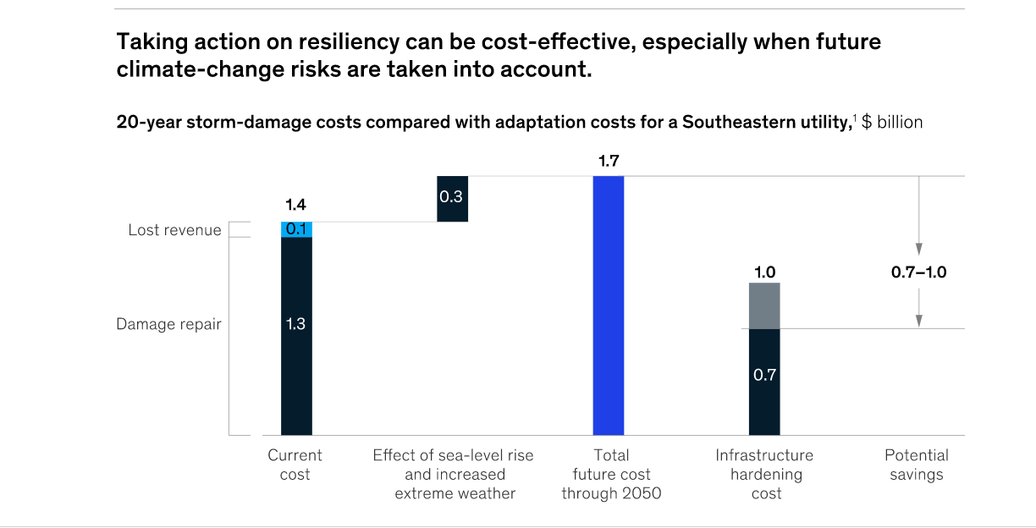

Slide 9
Actions
Harden the grid
Explore nonwire options that go beyond hardening the grid
  Decentralizing generation
  Battery storage
  Microgrids
  Environmental management
Factor an up-to-date view of risk of operations
Look for new partners to develop resilient strategies

Slide 10
Previous sessions assumed “public or market risks”
Based on option theory in financing
Assumption that all risk can be mitigated by hedging

Slide 11
Example (from previous session)
Demand = 270
Cost paid by BUS 1
$7.92 * 270MW * 8760 hrs = $18.732 million
p
Demand = 200
1 - p
Demand = 148
Cost paid by BUS 1
$7.85 * 148MW * 8760 hrs = $10.178 million

Slide 12
Hedge the risk: Purchase futures on price of energy (assume future price = LMP)
Revenue
$7.92 * X
Calculate X with assumption that cash flow is the same whether price = $7.92 or $7.85
$7.92X - $18.732 mil = $7.85X - $10.178 mil
X = 122.2 million
Whether future price is $7.92 or $7.85, cash flow in year 1 is $949 mil
Price = $7.92
p
Demand = 200
1 - p
Price = $7.85
Revenue
$7.85 * X
Park, C. S. (2016). Contemporary Engineering Economics, 6th edition, Hoboken, NJ: Pearson Higher Education.

Slide 13
No uncertainty = no risk!
Use risk-free interest rate (in our example 4.879%)
Under these assumptions, any decision maker (risk neutral, risk averse, risk seeking) would have the same value for a real option
Probability of demand increasing or decreasing is irrelevant in the problem
  Use “risk-neutral probability” for expected value calculations (in our example 0.5077 probability of demand increase)
  Risk-neutral probability does not really represent chance of demand increasing or decreasing

Slide 14
Risks for power producers and municipal utilities

Slide 15
Risk assessment answers 3 questions
What can go wrong?
What are the chances of it going wrong?
What are the consequences if it does go wrong?

Slide 16
Uncertainties in future electricity planning
Efficiency and capacity of renewable energy sources
Regulations especially capacity limits on coal and natural gas
Global warming and climate change
Rapidly changing industry
Cyber threats
Talent retention and new hires
Catastrophic events

Slide 17
What can be done to manage or mitigate the risks

Slide 18
Actions to mitigate risk
Harden the grid
Explore nonwire options that go beyond hardening the grid
  Decentralizing generation
  Battery storage
  Microgrids
  Environmental management
Factor an up-to-date view of risk of operations
Look for new partners to develop resilient strategies

Slide 19
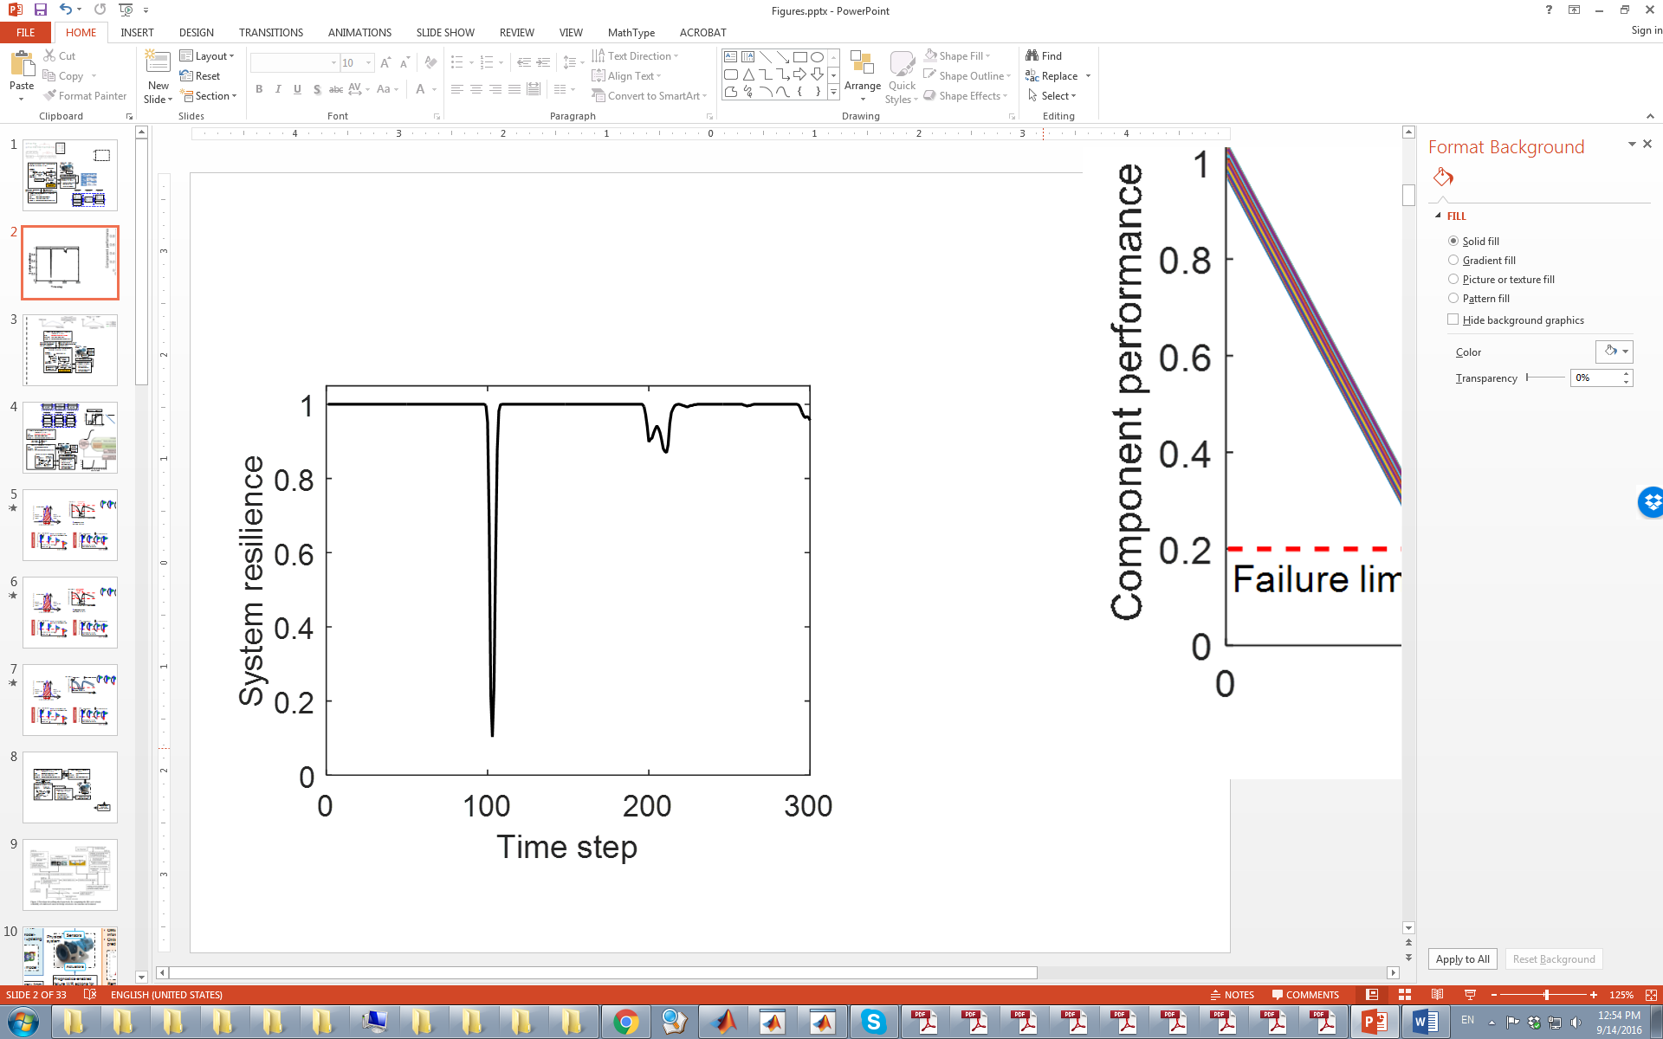
Design for reliability and resilience
How to design a system to increase its reliability and resilience?
  Redundancy
  Hardness
  Recovery
  Restoration

Slide 20
How to think about whether to engage in risk mitigation?
Assess risk by answering 3 questions
  Assess probabilities (can be very difficult!)
  Translate consequences to metrics (e.g., dollars lost)
Calculate consequences without risk mitigation
Calculate consequences with mitigation
Conduct risk-cost analysis to analyze
  Risk neutral decision maker
  Risk averse decision maker

Slide 21
Uncertain deal
Imagine that your organization is offered the following
$1 million
0.5
0.5
-$1 million
Would your organization take the deal?

Slide 22
Uncertain deal
Imagine that your organization is offered the following
$1 million
0.95
0.05
-$1 million
Would your organization take the deal?

Slide 23
Indifference point
$1 million
p
$0 ~
1-p
-$1 million
What is the value of p that makes your organization indifferent?
Different p → different risk attitudes

Slide 24
Risk attitude
Prefer gamble → risk seeking
Prefer sure thing
→ risk averse
0.5
$1 million
Expected value = $0
OR
$0
0.5
-$1 million
Indifferent → risk neutral

Slide 25
Example (assume risk of demand cannot be hedged)
Demand = 270
Cost paid by BUS 1
$7.92 * 270MW * 8760 hrs = $18.732 million
0.7
Add power source G1
0.3
Demand = 148
Cost paid by BUS 1
$7.85 * 148MW * 8760 hrs = $10.178 million
Demand = 270
Cost paid by BUS 1
$8.045 * 270MW * 8760 hrs = $19.028 million
Don’t add power source G1
0.7
0.3
Demand = 148
Cost paid by BUS 1
$7.85 * 148MW * 8760 hrs = $10.178 million

Slide 26
Value of installing power source at G1
Expected (average) cost with power source at G1
= [$18.732*0.7 + 10.178*0.3] / 1.05 = $16.166 million / 1.05
= $15.396 million
Note: exp(.0498*1) = 1.05 is the risk-free interest rate for 1 year
Expected (average) cost without power source at G1
= [$19.028*0.7 + 10.178*0.3] / 1.05 = $16.373 million / 1.05
= $15.593 million
Value of installing power source at G1
= $15.593 – 15.396 = $0.197 million
Only install power source if cost of power source less than $197,000

Slide 27

Risk tolerance
Find your organization’s risk tolerance
Risk tolerance (in millions of dollars) = $1/{\ln\left(\frac{p}{1−p}\right)}$
$1 million
p
$0 ~
1-p
-$1 million

Slide 28
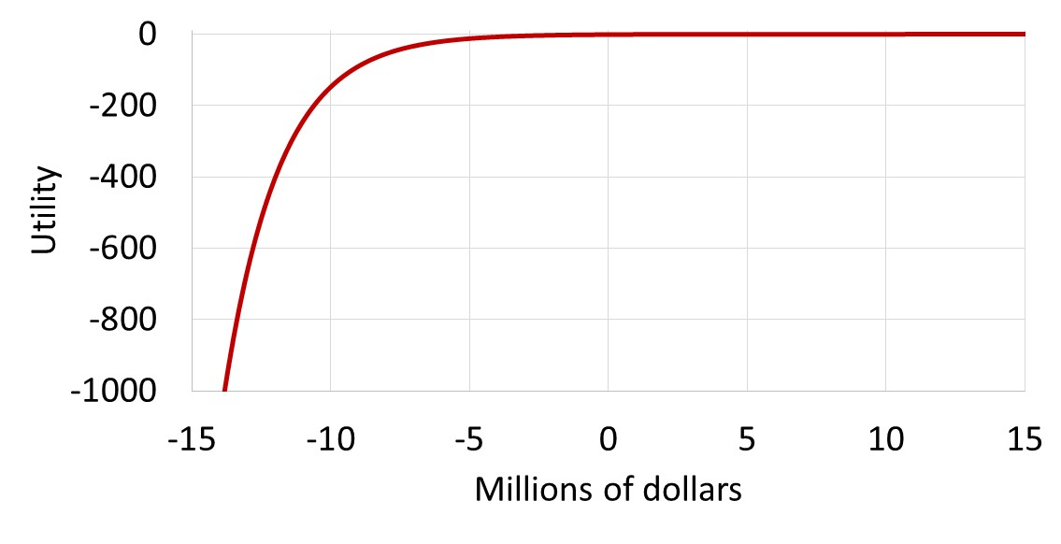
Risk-averse utility function

Slide 29
Exponential utility function
U(x) = 1 – exp(-x / risk tolerance)
Example with profit or revenue
  Risk tolerance = $2 million
  Profit = $3 million
  U(3) = 1 – exp(-3/2) = 0.777
Example with cost
  Risk tolerance = $2 million
  Cost = $10 million (treat cost as a negative number)
  U(-10) = 1 – exp(10/2) = -147.413

Slide 30
Example with risk aversion
Demand = 270
U(-$18.732 million / 1.05) = -1384.06
0.7
Add power source G1
0.3
Demand = 148
U(-$10.178 million / 1.05) = -49.93
Demand = 270
U(-$19.028 million / 1.05) = -1551.78
Don’t add power source G1
0.7
0.3
Demand = 148
U(-$10.178 million / 1.05) = -49.92

Slide 31
Value of installing power source at G1
Expected (average) utility with power source at G1
= -1384.06*0.7 – 49.93*0.3 = -983.82
Expected (average) utility without power source at G1
= -1551.78*0.7 – 49.93*0.3 = -1101.22
Convert utilities back to dollars in cost using certain equivalence
  CE (-983.82) = 2.47 mil * ln(1 + 983.82) = $16.999 million
  CE (-1101.22) = 2.47 mil * ln(1 + 1101.22) = $17.277 million
Value of installing power source at G1
= $17.277 – 16.999 = $0.277 million
Install power source if cost of power source less than $277,000

Slide 32
Insights from risk-averse decision making
Most people are risk averse
  Avoid bad outcomes
  Willing to sacrifice chances of some good outcomes to reduce the chances of bad outcomes
The more risk averse you or your organization is
  The more you should be willing to do now to protect against future risks
  The more you should be willing to spend now to avoid potential bad outcomes
An organization should not be so risk averse it forgoes good opportunities

Slide 33
Choosing among alternatives
(risk-benefit trade-off)
Risk-seeking
Risk-neutral
Measure of the benefits
Risk-averse
Probability of failure
Variance
Risk

Slide 34
Risk-cost curve
Risk-seeking
Risk
Risk-neutral
Risk-averse
Cost of risk mitigation

Slide 35
Design for reliability and resilience
What is the optimal level of resilience for a system?

Slide 36
Can all risk be hedged in the market?
Integrated valuation procedure (Smith and Nau 1995, Smith and McCardle 1998)
If a risk is a market or public risk (i.e., can be perfectly hedged in the market) use risk-neutral probabilities and risk-free rate to calculate value of options
If a risk is a private risk that cannot be hedged in the market (e.g., uncertainties about production) use subjective probabilities and
  Risk-free rate and expected NPV if decision maker is risk neutral
  Risk-averse utility function if decision maker is risk averse
Smith, J. E. & Nau, R. F. (1995). Valuing risky projects: Option pricing theory and decision analysis. Management Science 41(5): 795-816.
Smith, J. E. & McCardle, K. F. (1998). Valuing oil properties: Integrating option pricing and decision analysis approaches. Operations Research 46(2): 198-217.

