Slide 1
Module 4: Section 2: A guide on option valuation
Gazi Nazia Nur
IMSE, ISU
email: nazianur@iastate.edu

Slide 2
Introduction
This is a guide to assist users to understand the contents of the excel file “Option valuation” which is the section 1 of module 4
In our example, the option is adding a generator to the network
We are assuming:
The option is a European call option (only be exercised at expiration) for simplicity
The option is can be exercised at expiration after knowing the demand at that time period

Slide 3
Introduction
Option value is calculated from option value tree
The option value tree is derived from the demand lattice which is present in the “Demand lattice” sheet
To solve the problem, we are considering two cases
Case 1: A generator is not added to bus 1 (of the network used in module 1 and 2)
Case 2: A generator is added to bus 1 (of the network used in module 1 and 2)

Slide 4
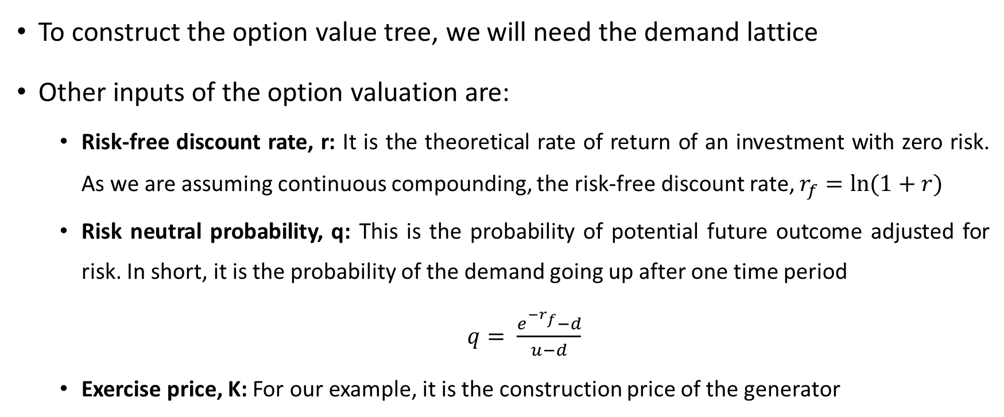
Input of option valuation
To construct the option value tree, we will need the demand lattice
Other inputs of the option valuation are:
Risk-free discount rate, r: It is the theoretical rate of return of an investment with zero risk. As we are assuming continuous compounding, the risk-free discount rate, $r_{f}=ln⁡(1+r)$
Risk neutral probability, q: This is the probability of potential future outcome adjusted for risk. In short, it is the probability of the demand going up after one time period
$q= \frac{e^{−r_{f}}−d}{u−d}$
Exercise price, K: For our example, it is the construction price of the generator

Slide 5
Process of option valuation
The process of calculating the option value is:
Step 1- Determining locational marginal prices (LMP): The first step is determining LMPs separately for each demand of the demand lattice for both case 1 and 2
Step 2- Calculating the cost: The next step is to calculate the cost paid by the community to fulfil their electricity demand for both cases using the following formula:
Cost paid by the community Yearly = Demand at that time period x LMP to fulfil the demand x 8760
Here, 8760 is the number of hours in a year

Slide 6
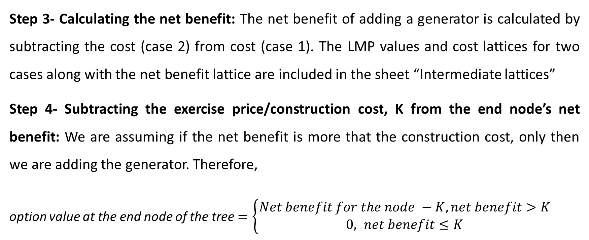
Process of option valuation
Step 3- Calculating the net benefit: The net benefit of adding a generator is calculated by subtracting the cost (case 2) from cost (case 1). The LMP values and cost lattices for two cases along with the net benefit lattice are included in the sheet “Intermediate lattices”
Step 4- Subtracting the exercise price/construction cost, K from the end node’s net benefit: We are assuming if the net benefit is more that the construction cost, only then we are adding the generator. Therefore,
option value at the end node of the tree$=\left\{\begin{aligned}Net benefit for the node −K,net benefit>K \\ &0, net benefit≤K\end{aligned}\right.$

Slide 7
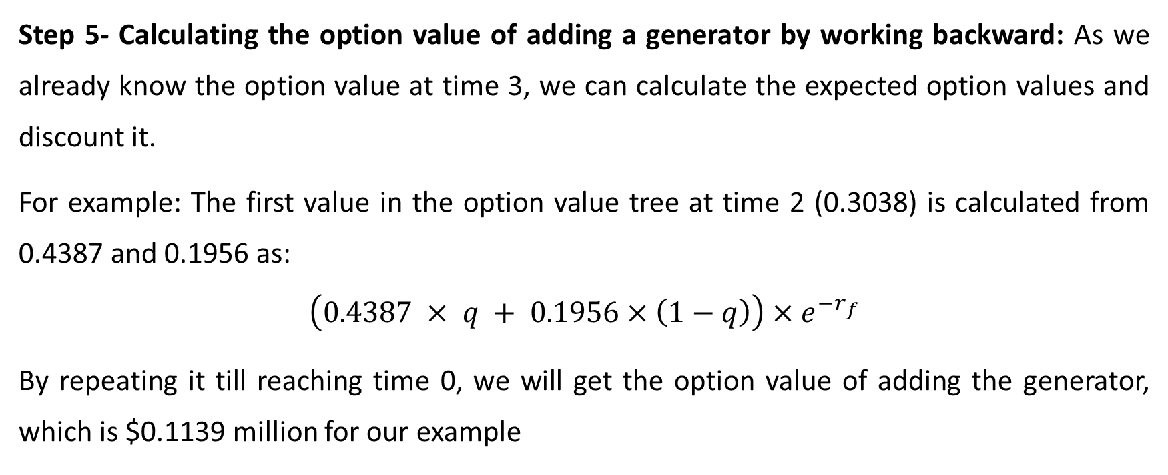
Process of option valuation
Step 5- Calculating the option value of adding a generator by working backward: As we already know the option value at time 3, we can calculate the expected option values and discount it.
For example: The first value in the option value tree at time 2 (0.3038) is calculated from 0.4387 and 0.1956 as:
$$\left(0.4387 × q + 0.1956×\left(1−q\right)\right)×e^{−r_{f}}$$
By repeating it till reaching time 0, we will get the option value of adding the generator, which is $0.1139 million for our example

Slide 8
Output of option valuation
On the right side of the excel sheet “Option valuation”, a option value tree for three time period is constructed and the option value is calculated
The value in the shaded box is the option value of adding a generator at time 3
It can be also be called the license value of the generator

Slide 9
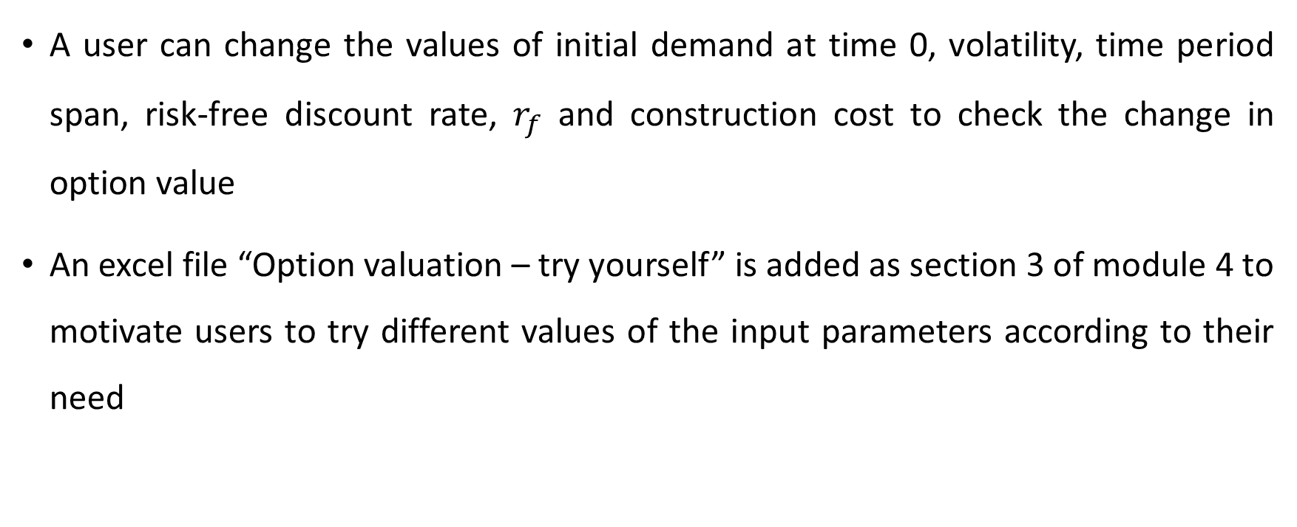
Conclusion
A user can change the values of initial demand at time 0, volatility, time period span, risk-free discount rate, $r_{f}$ and construction cost to check the change in option value
An excel file “Option valuation – try yourself” is added as section 3 of module 4 to motivate users to try different values of the input parameters according to their need

