Slide 1
Module 3: Section 2:
A guide on demand lattice
Gazi Nazia Nur
IMSE, ISU
email: nazianur@iastate.edu

Slide 2
Introduction to demand lattice
This is a guide to assist users to understand the contents of the excel file “Demand lattice” which is present as section 1 of module 3
Lattice is used to map the evolution of a random variable with time
In our example, we are constructing a binomial demand lattice
  For three time periods
  Assuming the demand follows geometric Brownian motion (gBm)

Slide 3
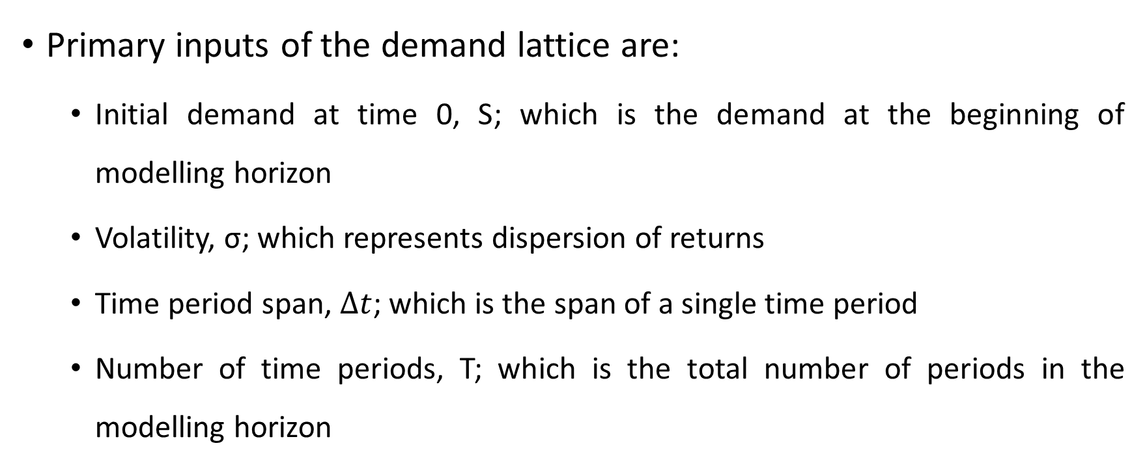
Input of demand lattice
Primary inputs of the demand lattice are:
  Initial demand at time 0, S; which is the demand at the beginning of modelling horizon
  Volatility, σ; which represents dispersion of returns
  Time period span, $Δt$; which is the span of a single time period
  Number of time periods, T; which is the total number of periods in the modelling horizon

Slide 4
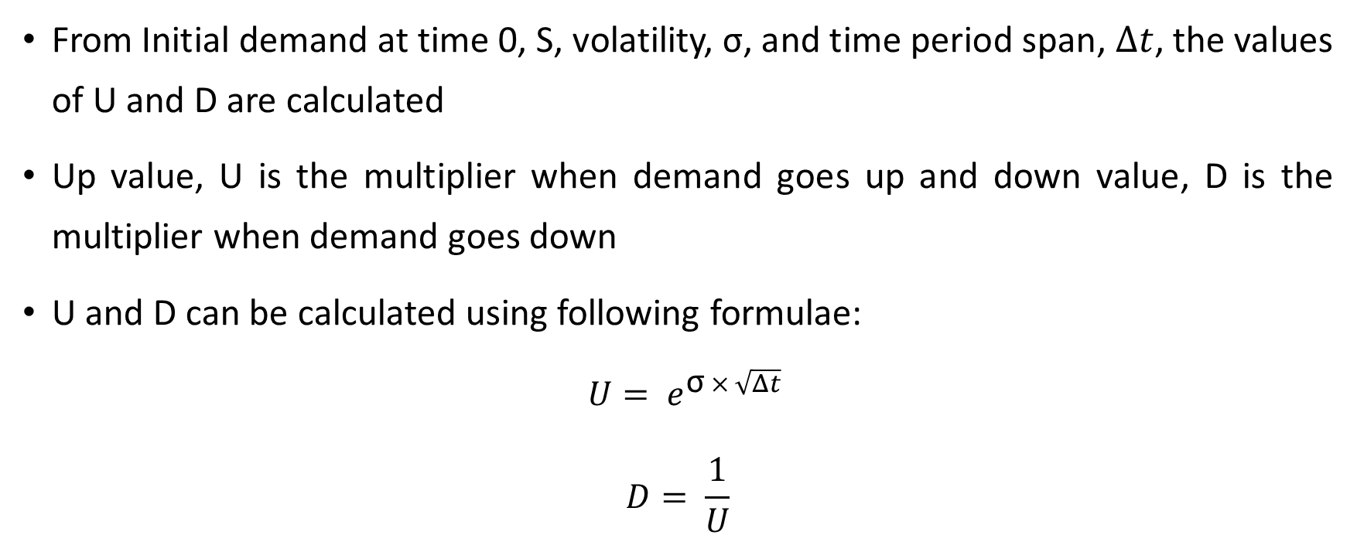
Input of demand lattice
From Initial demand at time 0, S, volatility, σ, and time period span, $Δt$, the values of U and D are calculated
Up value, U is the multiplier when demand goes up and down value, D is the multiplier when demand goes down
U and D can be calculated using following formulae:
$U= e^{\text{σ} × \sqrt{Δt} }$
$$D= \frac{1}{U}$$

Slide 5
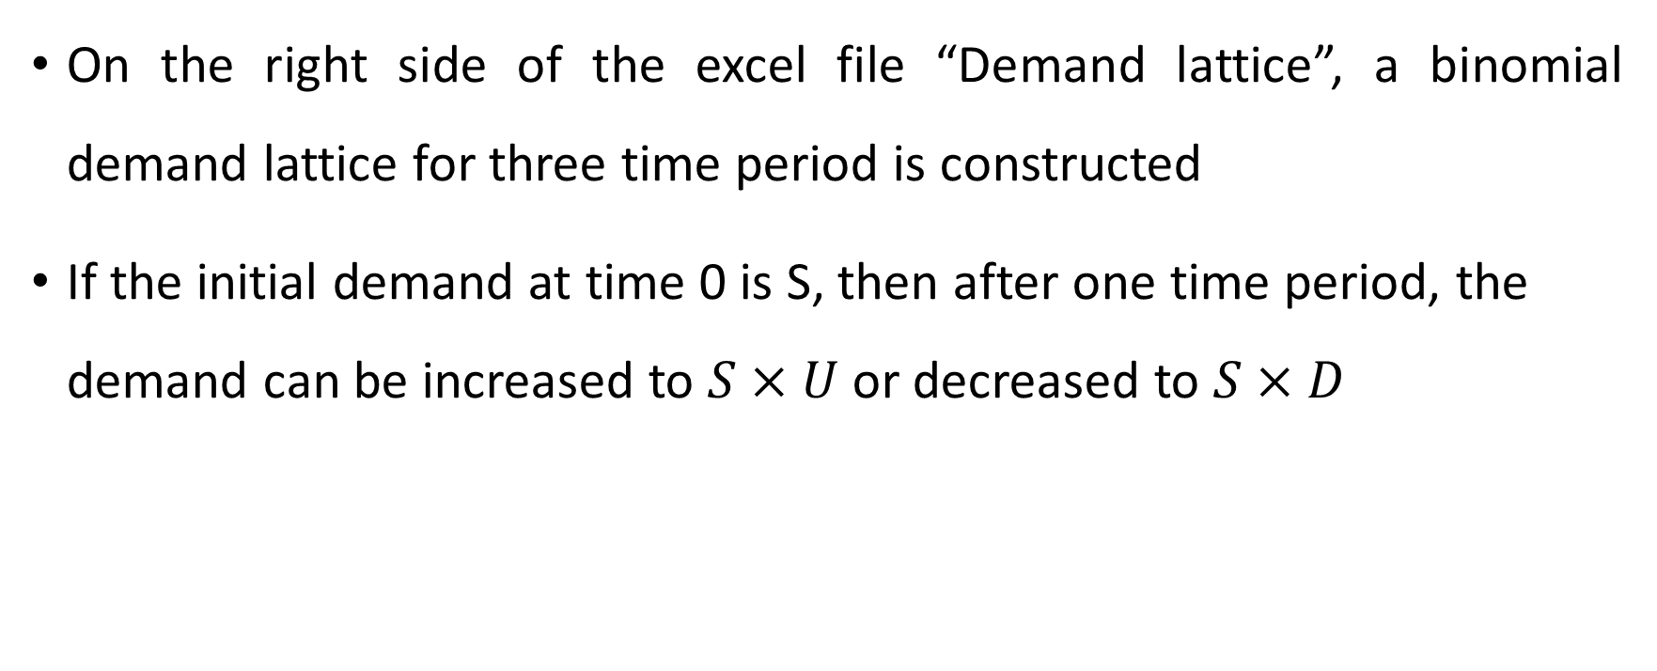
Output of demand lattice
On the right side of the excel file “Demand lattice”, a binomial demand lattice for three time period is constructed
If the initial demand at time 0 is S, then after one time period, the demand can be increased to $S×U$ or decreased to $S×D$

Slide 6
Output of demand lattice
Demand will continue to evolve following the same formula for future time periods
For three time periods, the demand lattice will be following:

Slide 7
Conclusion
  A user can change the values of initial demand at time 0, volatility and time period span to check how it affects the values of U and D, and how the output (demand lattice) changes
  An excel file “Demand lattice – try yourself” is added as section 3 of module 3 to motivate users to try different values of the input parameters according to their need

