Slide 1
Electric Power Transmission Lines and Power Outages in Iowa
09/29/2020

Slide 2
Congestion in Power Systems
In an open access environment, power flows from suppliers to consumers with transactions happening through transmission lines. Congestion takes place when the transmission lines are not sufficient to transfer the power according to market desires.
(Pillay, Anusha, S. Prabhakar Karthikeyan, and D. P. Kothari. "Congestion management in power systems–A review." International Journal of Electrical Power & Energy Systems 70 (2015): 83-90.)

Slide 3
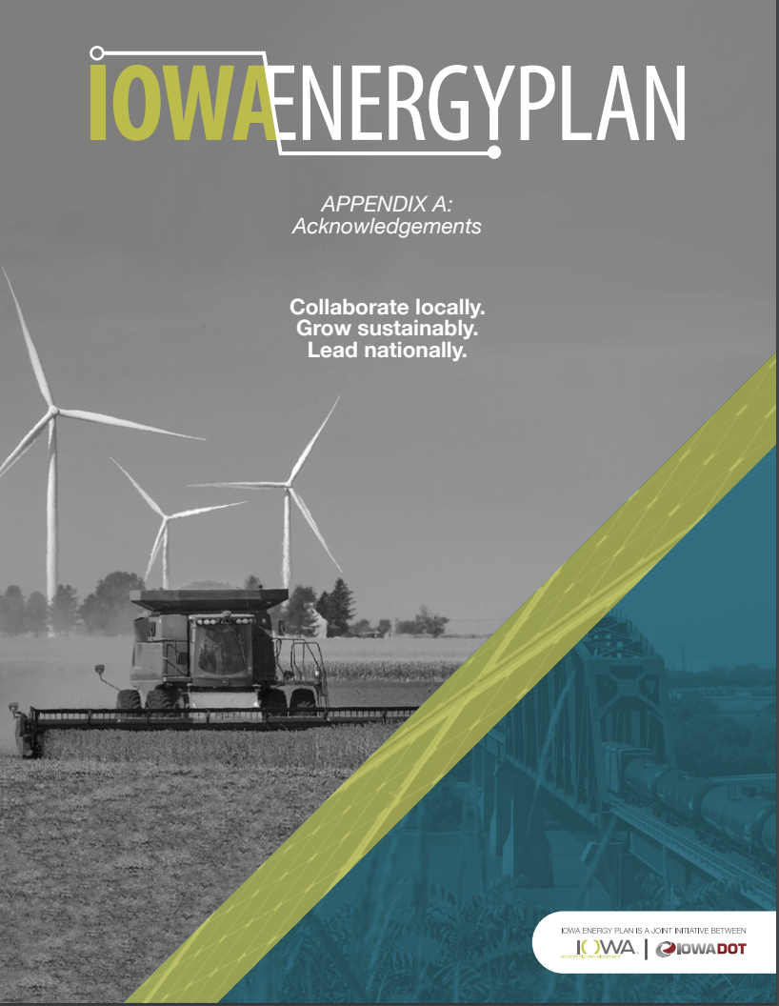
Iowa Energy Plan
http://www.iowaenergyplan.org/
http://www.iowaenergyplan.org/resources.html
http://www.iowaenergyplan.org/docs/IEP_Appendices_full.pdf

Slide 4
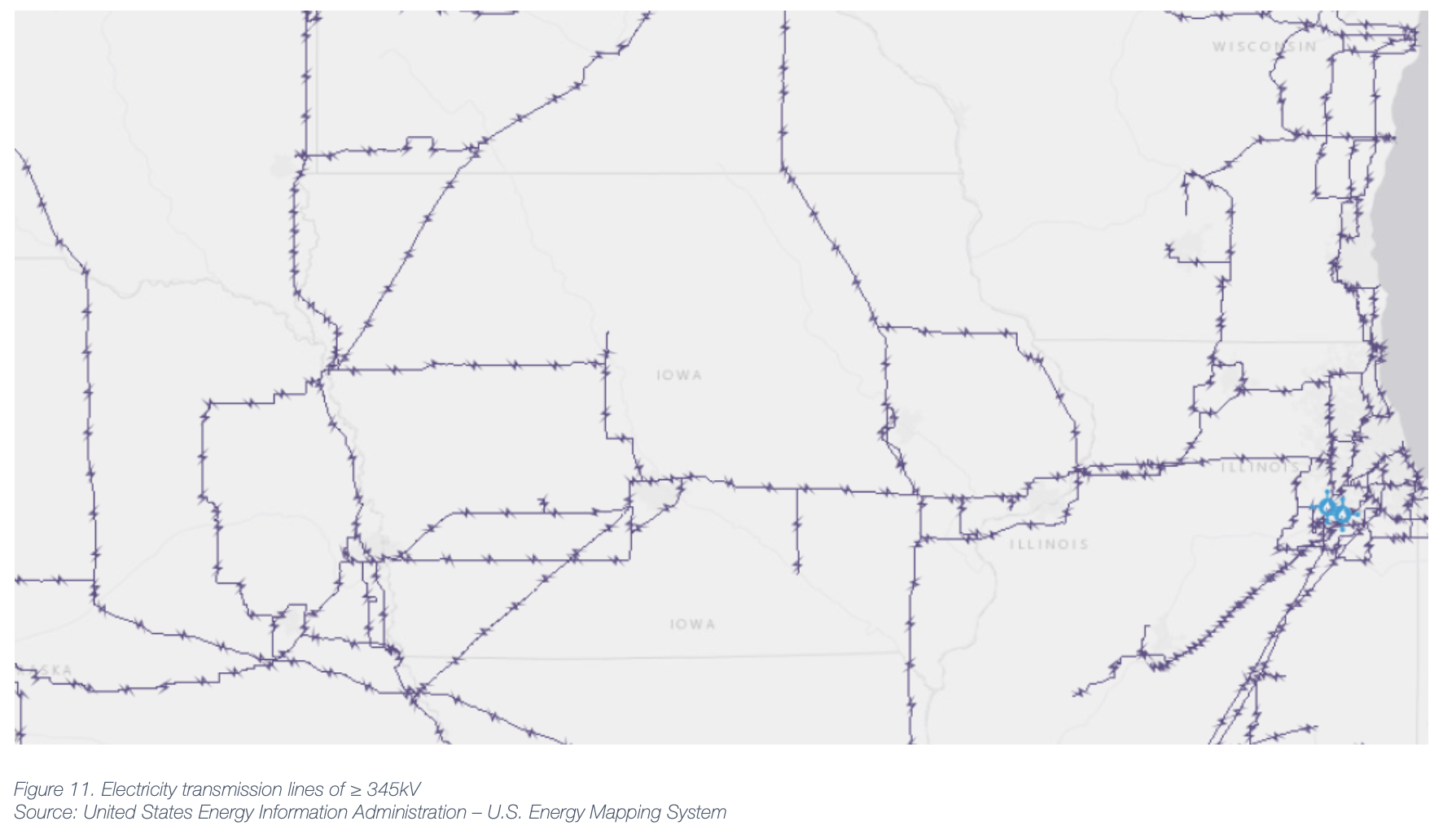
Major Electricity Transmission Lines

Slide 5
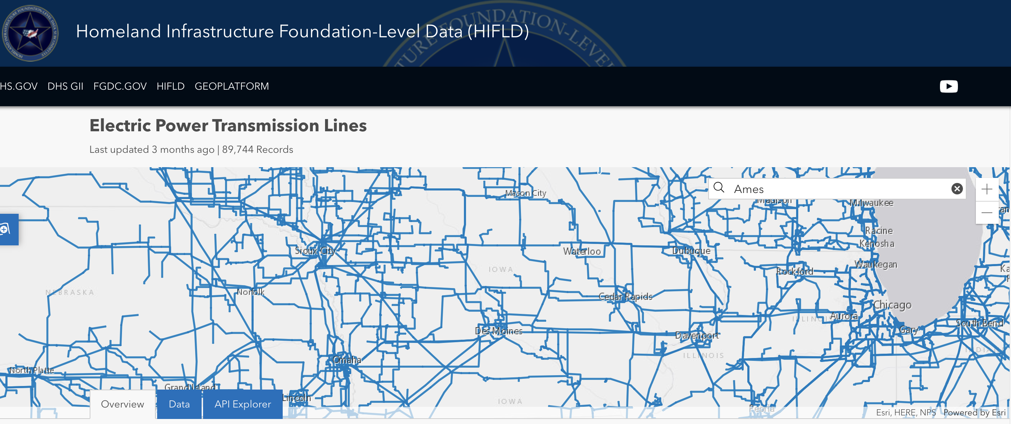
Homeland Infrastructure Foundation-Level Data (HIFLD)
https://hifld-geoplatform.opendata.arcgis.com/datasets/electric-power-transmission-lines?geometry=-97.290%2C40.581%2C-89.951%2C43.438

Slide 6
Information of Each Transmission Line

Slide 7
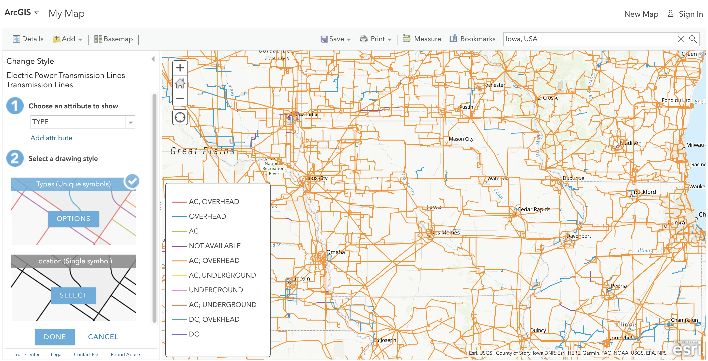
The Type of Transmission Lines
https://www.arcgis.com/home/webmap/viewer.html?panel=gallery&suggestField=true&url=https%3A%2F%2Fservices1.arcgis.com%2FHp6G80Pky0om7QvQ%2Farcgis%2Frest%2Fservices%2FElectric_Power_Transmission_Lines%2FFeatureServer%2F0

Slide 8
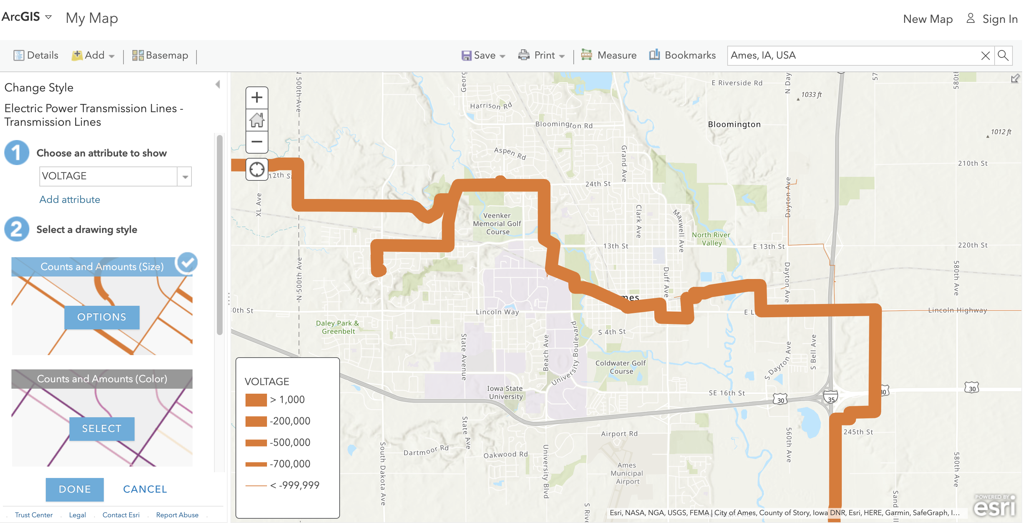
The Voltage of Transmission Lines

Slide 9
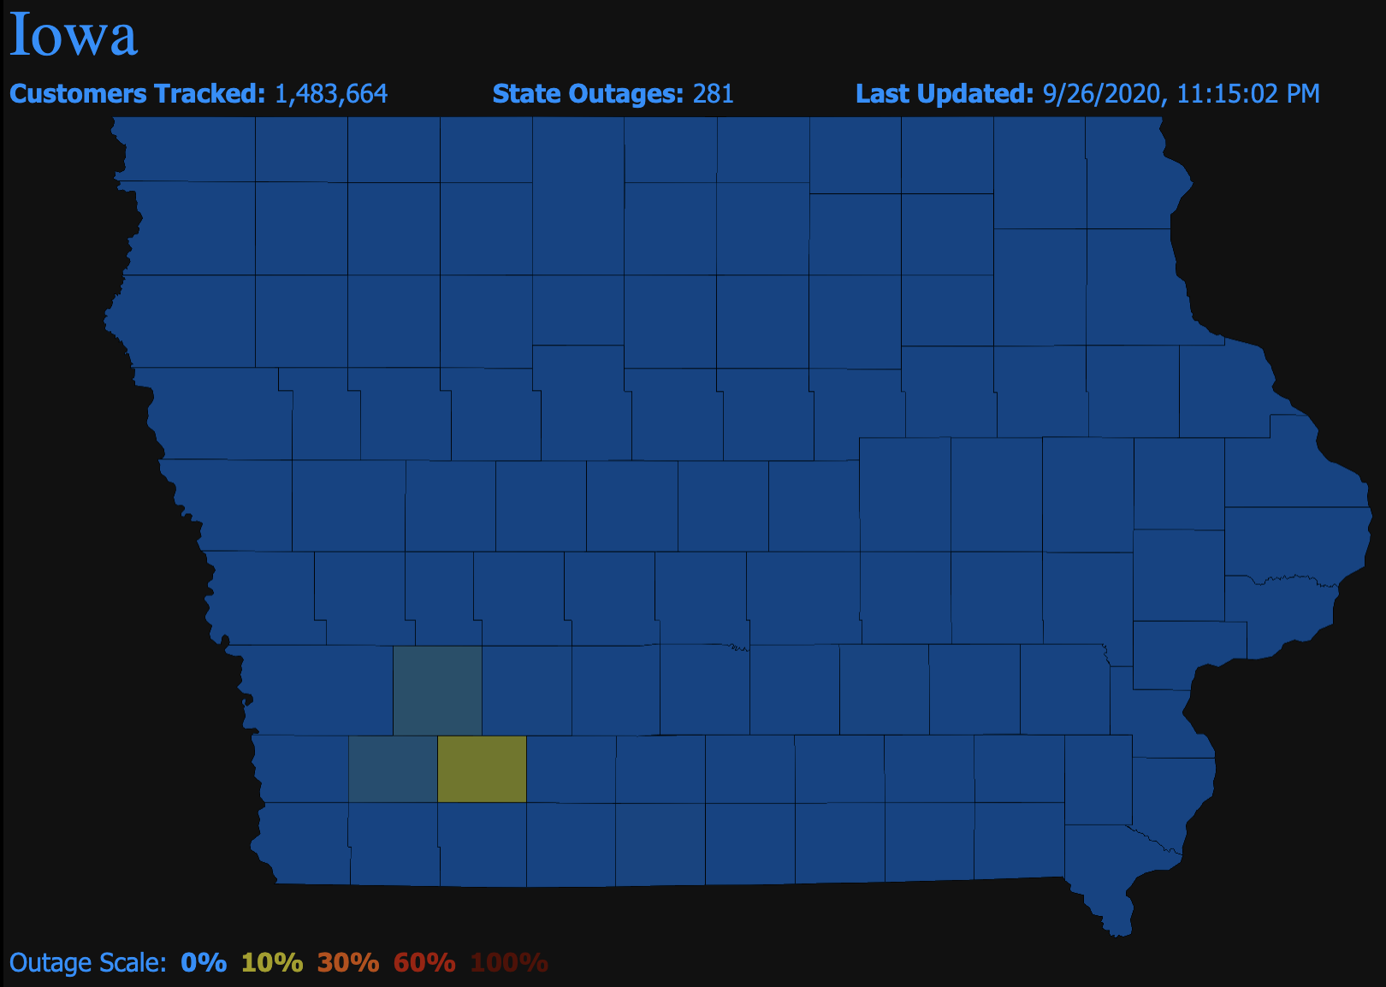
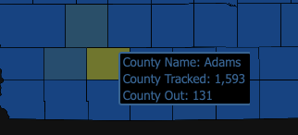
Iowa Power Outages Map (Real Time)
https://poweroutage.us/area/state/iowa

Slide 10
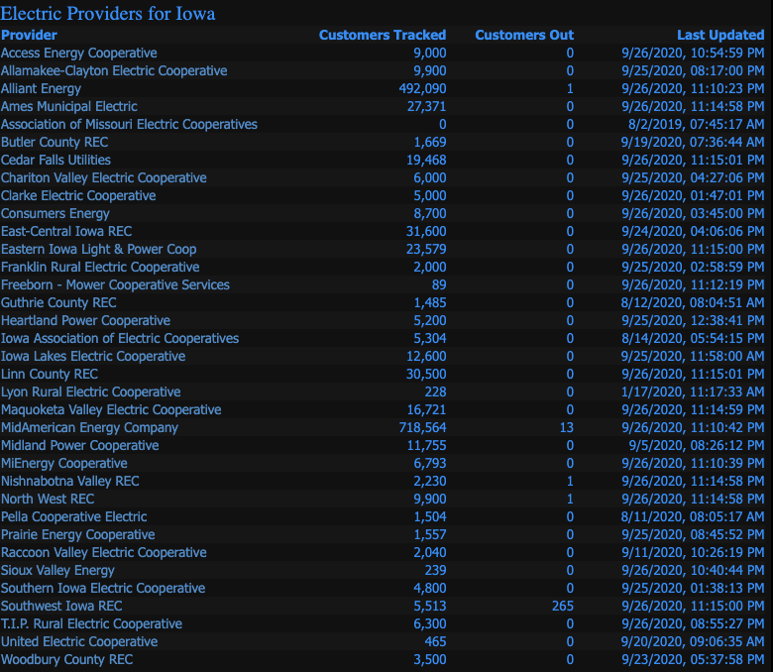
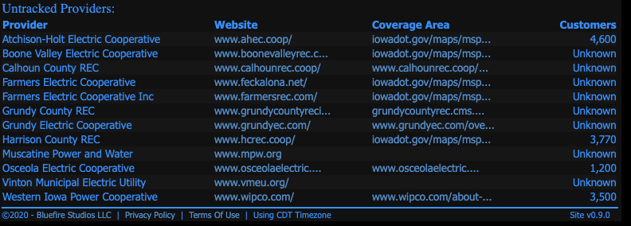
Iowa Power Outages Map

Slide 11
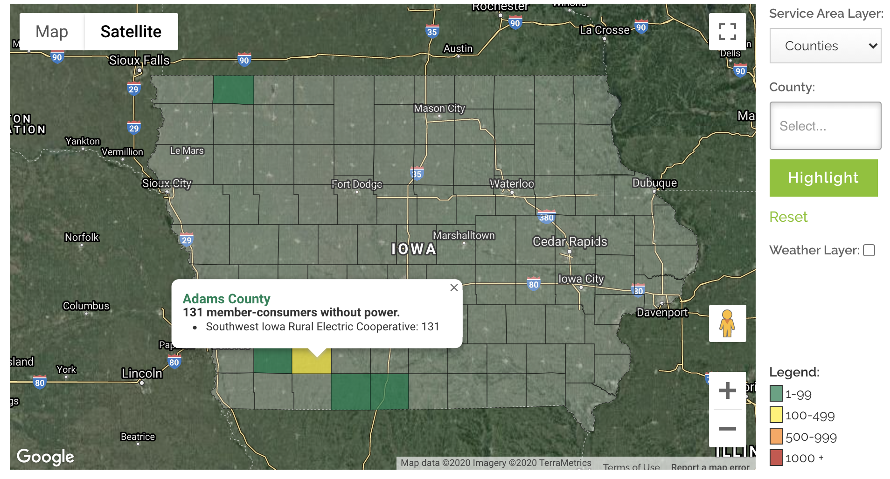
Outages (Real Time) Iowa Association of Electric Cooperatives
https://www.iowarec.org/outages

Slide 12
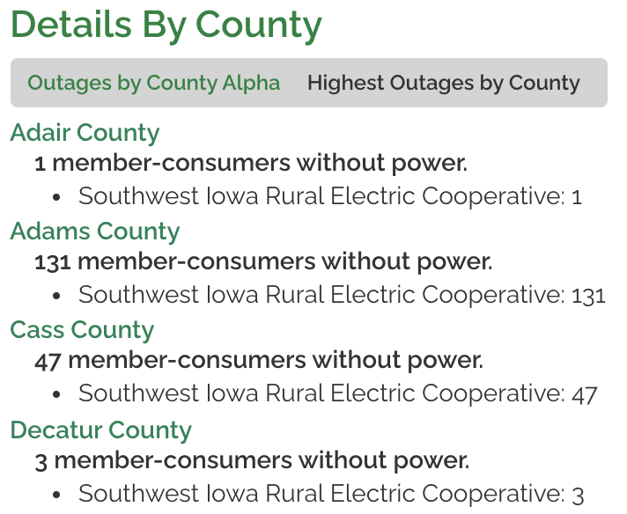
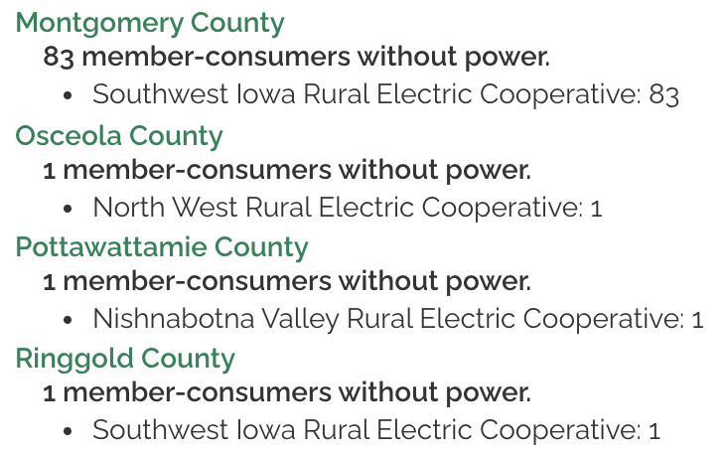
Details By County

Slide 13
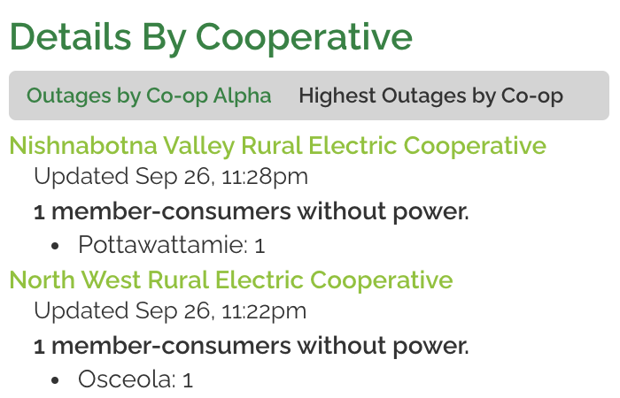
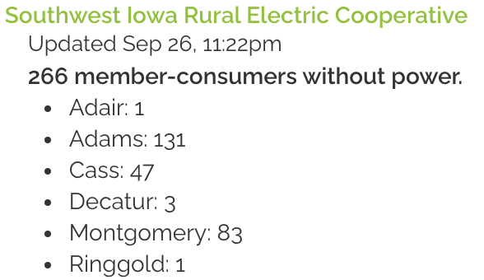
Details By Cooperative

Slide 14
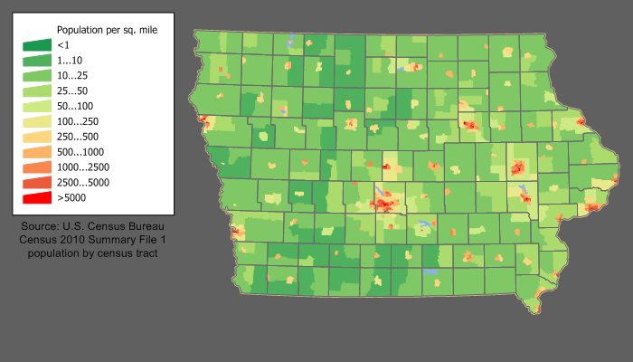
Iowa Population Density
https://en.wikipedia.org/w/index.php?title=File:Iowa_population_map.png

