Slide 1
Active Shooter Situations: An Agent-Based Model of Civilian Response Strategy
Alexandria Stewart
Cameron MacKenzie
Presentation to SRA Annual Meeting
December 9, 2019

Slide 2
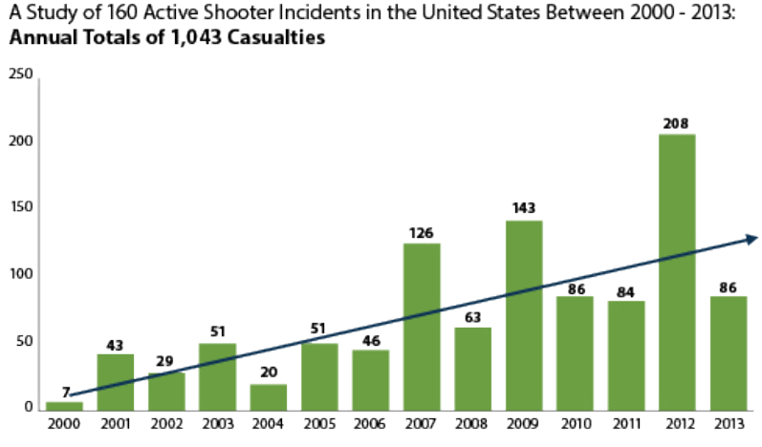
Number of active shooter incidents in the United States, 2000-2013 (Blair and Schweit, 2014)
2
Notes:
1. The definition of an active shooter, as agreed upon by U.S. government agencies, is “an individual actively engaged in killing or attempting to kill people in a confined and populated area”.
2. Total 1,274 casualties (dead and wounded) – 578 killed, 696 wounded.
3. 2000 – 2007: avg 7.4 incidents per year. 2008 – 2015: avg 17.6 incidents per year.
4. 45 of 200 – almost ¼ - occurred at educational facilities. 88 of 200 occurred in areas of commerce.
5. 70% ended in 5 minutes or less.
6. 80 of 200 – shooter committed suicide. 39 of 200 – police killed shooter. 26 of 200 – unarmed civilians intervened.

Slide 3
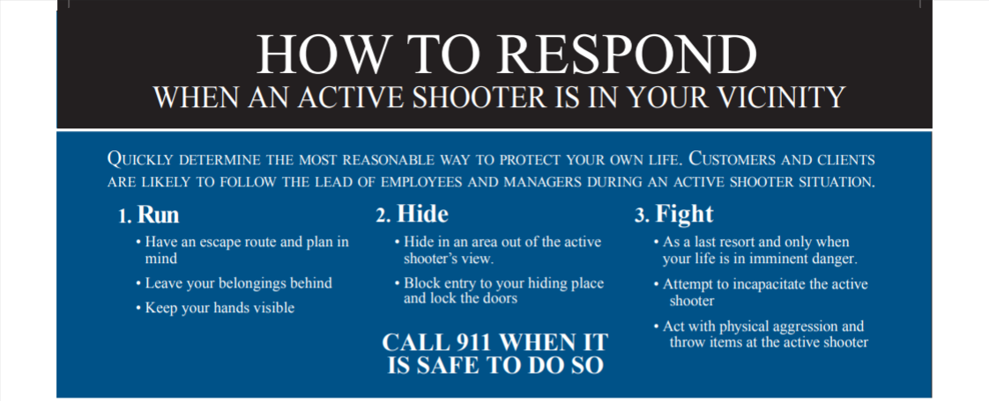
Introduction
Columbine High School
Prompted changes in law enforcement response strategy
Previously approached as hostage situation
Now first officers on scene enters
Prompted changes in civilian response strategy training
Previously “Lockdown”
Now “Run, Hide, Fight” (U.S. Department of Homeland Security)
3
Notes:
1. Shooting rampage in Littleton, CO resulting in the deadliest high school shooting in US history. This was one of the first high-profile crimes where the motives of the shooter did not align with “traditional” criminals; the shooters were not motivated by financial gains or political or religious radicals.
2. SWAT entered 47 minutes after shooting started, but police had arrived 30 minutes prior to SWAT arriving. After analyzing the Columbine shooting and realizing the need for very quick response times, law enforcement officers had a lot of training to get done. SWAT level training for all line officers is unreasonable.
3. “Lockdown” method: civilians lock all doors, if possible, and hide as best they could. Because of habits and motives of active shooters, police realized this method may not be the best method in many shooting scenarios. Now often train using the “Run, Hide, Fight” method used by U.S. Dept of Homeland Security. ALERRT (Advanced Law Enforcement Rapid Response Training) Center – named the national standard by the FBI in 2013 – uses a similar strategy called “Avoid, Deny, Defend”.

Slide 4
Research Objectives
Motivation:
Increasing number of active shootings per year
Change in police and civilian response strategy trainings
Difficult policy question about what is the best to prevent and respond to these situations
Purpose: Understand how law enforcement and civilian responses to an active shooting can impact the number of casualties
4

Slide 5
Agent-based simulation
Simulates actions and interactions of autonomous agents
Assesses effect that agents have on the system as a whole
Why?
Limited amount of data
Analyze a wide variety of situations
Understand the impact of different parameters
5
Notes:
You might be asking yourself “why an agent-based simulation?” Definition: Agent-based simulations are a type of computational model in which the actions and interactions of autonomous agents are simulated. The motivation behind using these simulations is to assess the effects that the agents have on the system as a whole. These types of simulations are used to analyze complex systems that have interacting decision makers, often human
Why for active shootings? Limited amount of data from active shootings. Gaps in available data. Simulations can allow us to assess a wide variety of situations in a short time period with different attributes for each agent (civilians, shooters, law enforcement). Can look at various parameters such as firearm capacity, accuracy of the shooters, presence of a security guard, or some like I looked at such as cognitive delay of the civilians or civilian response strategy and assess their affects on the number of casualties.

Slide 6
Agent-based simulations on active shooters
Armed civilians in educational environment (Kirby, Anklam, Sharevski, and Dietz, 2015; Kirby, Adam, Anklam, and Dietz, 2016)
Assault weapons and high-capacity magazines bans (Hayes and Hayes, 2014)
Unarmed civilians who engage the shooter (Briggs and Kennedy, 2016)
This agent-based simualtion
School shooter where shooter moves between classrooms
Quantifies effects of police response time and civilian response strategy
Notes:
Benefits: Simulations can help law enforcement be more proactive. Like mentioned earlier, we can go through a variety of situations with changing parameters and assess the best response strategies – for civilians and law enforcement. Available data is limited.
Limitations: Depicting real world scenarios is tough, especially in chaotic situations. Difficult to model how people react because emotional states, individual knowledge of the situations, and cognitive-decision making cannot accurately be taken into account.
Going to talk about some of the prior models and the factors they have observed.
Set in an educational environment and has four different scenario. 1. No type of access control or security at the school. 2. 5 – 10% of the school work force are concealed carry civilians. 3. The school has a designated resource officer on staff. 4. The school has a resource officer and 5 – 10% of the school work force are concealed carry civilians. Civilians are in 3 predetermined locations (classroom, cafeteria, office) and the shooter randomly selects which location to go to. Shooter stays for set amount of time (2-5 min). If CC, shooter will be engaged. If RO, they must be dispatched to come to room and then engage shooter. Scenario 4 proved to be the most beneficial in reducing the number of casualties, while scenario 1 – with no access control or security – proved to be the least beneficial. The conclusion of the study was that a quicker response is key to reducing the number of casualties.
Setting of a one-story office building with 15 individuals in the workplace. Exterior room doors can be locked. The results from this model suggest slightly reduced time to engage the shooter and slightly reduced number of casualties if there are 10% of the employees who have concealed carry weapons. The results indicate significantly reduced time to engage the shooter and significantly reduced number of casualties if there is a security guard present. Locking doors does not influence the time to engage the shooter but does appear to reduce the number of casualties in the incidents by almost 25%.
3. Three simulations in NetLogo. Purpose was to observe the potential effectiveness of an assault weapons and high-capacity magazines bill. Two indoor and one outdoor (to see if parameters matter more or less given the setting). First model used to validate their model: Aurora, CO. Second was the large indoor space. Then large outdoor space. From the results of their simulation models, they concluded that the assault weapons ban would not decrease the number of casualties (because the ban did not include decreasing the rate of fire of any firearm). Of the parameters tested in the model, Hayes and Hayes found that the weapon’s rate of fire has the greatest effect on the number of casualties; this was especially true for indoor simulations. They also concluded that the high-capacity magazine ban would result in a small number of lives saved during a mass shooting.
4. The model was set in a large, open outdoor area, and included unarmed civilians who fight back against the shooter. The shooter is randomly placed at the start of the simulation and begins shooting at the closest civilians. While most civilians will flee, a small portion will head towards to shooter to try to subdue them. The simulation ends when the shooter is subdued or all civilians have been hit or have escaped outside the perimeter of the simulation. The results of the Briggs and Kennedy model suggest that unarmed resistance may reduce the overall number of casualties in an active shooter situation. The risk of being shot does greatly increase for the individuals who choose to fight the shooter. Importantly, the authors discuss limitations of the model and note that all active shooting models are limited by the amount of forensic information from past active shootings; this lack of information increases the complication of validating active shooting models.
Given what you now know about past active shooter agent-based simulations, you might be interested in knowing what is different about the work I have done.
Simulating a school shooting environment in an enclosed area with civilians located in various classrooms. The shooter is moving through the rooms similar to how they may be expected to move through rooms in a real situation.
I have attempted to quantify the effects of factors that have not been looked at before. Civilian response strategy was the biggest one that has not been approached at all yet in this area of research. Police response time in this type of environment is another factor that has not yet been quantified.

Slide 7
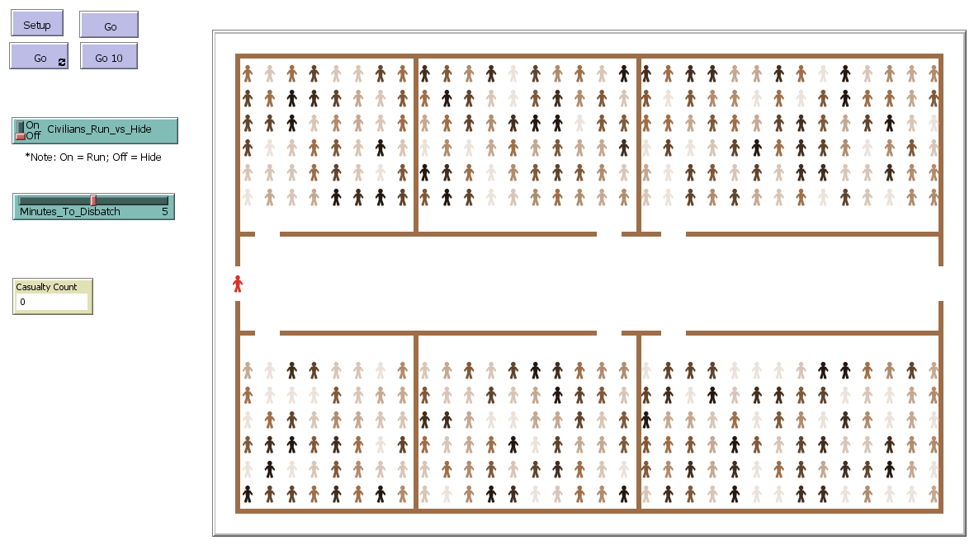
Simulation in NetLogo
7
Notes:
So now actually getting in to the details of my simulation model. Parameters in table at the top right.
Initial assumptions: firearm effective ranges, field of view, shooter mag capacity, running speed.
Modifiable parameters: civilian response strategy, police response time, (cognitive delay).
3 types of active agents: greens, blues, reds
Setup: creates walls and place civilians in 6 classrooms. 384 total civilians. Shooter starts at the left entrance/exit door. Casualty count set to zero. Cognitive delay is set. Running speeds assigned based on normal distributions. Response strategy is determined. For the combo situation, random number between 0 and 1 is assigned to each agent. Less than 0.5 will run. Greater than or equal to 0.5 will hide.
Model can then be run. Will stop if there are no active shooters, or if there are no civilians. Civilians follow chosen response strategy once shots have been fired and cognitive delay has been reached.

Slide 8
Parameter for agent-based simulation
Parameter | Values | Notes
Police response time | 2 min 5 min 10 min | Time it takes for police to arrive on scene
Civilian response strategy | All run All hide Some run and some hide | Whether civilians choose to evacuate or to lockdown
Cognitive delay | 0.5 min 1 min 2 min 5 min | Time it takes for civilians to process and respond to situation
8

Slide 9
Simulation video
9
Notes:
Quick video clip of one simulation situation. All civilians run, 5 min police response time, 1 minute cognitive delay.
Target selection: shooter looks for closest civilian. Face them and head towards them (avoiding walls). Will choose a link-neighbor if there is one. Then anyone else in firearm effective range and field of view. Once in firearm effective range (which is short), civilian will become a casualty, the mag decreases by 1, and target selection starts over.
Law enforcement officers arrive at designated time. Select shooter as target.
Civilians operate on a coordinate system. Cannot run over each other – hence bottlenecks at the doors.
36 different simulation sets – 4 cognitive delays x 3 police response times x 3 response strategies. 50 trials of each. Output variable is the number of casualties AKA the number of civilians who were shot.

Slide 10
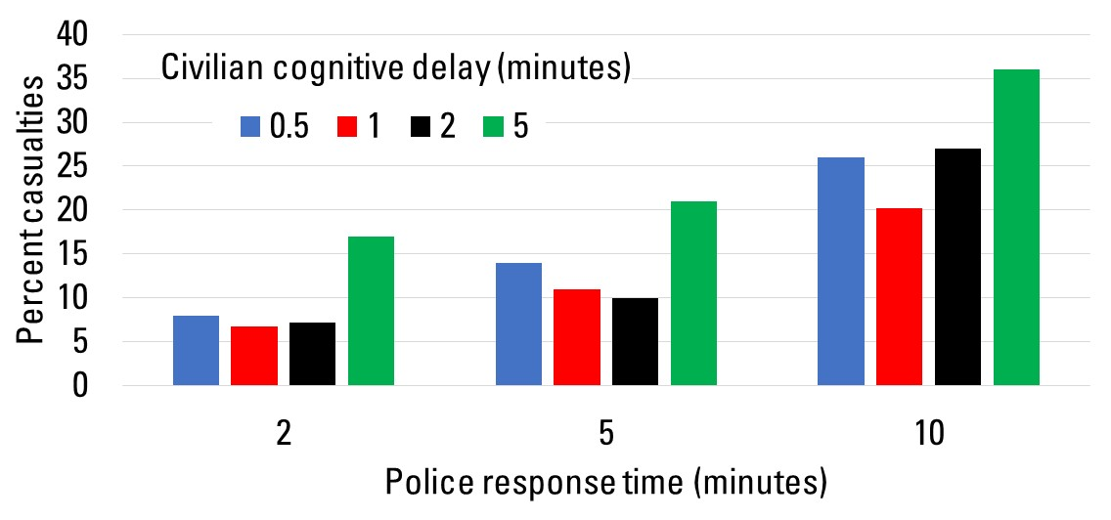
Percent of casualties by cognitive delay when all civilians run
10
Notes:
Graph showing raw data for when the civilian response strategy is for all civilians to run.
It is evident that a 5-minute cognitive delay time increased the number of casualties, but there was little difference between the 30-second, 1-minute, or 2-minute cognitive delay times for each police response time.
As the police response time increases, there is a clear increase in the number of casualties. The 2-minute police response time has casualty percentages around 7-8% for the shorter cognitive delay times, while the 10-minute police response times are around 25-27% for the shorter cognitive delay times and up to 35% for the 5-minute cognitive delay time.

Slide 11
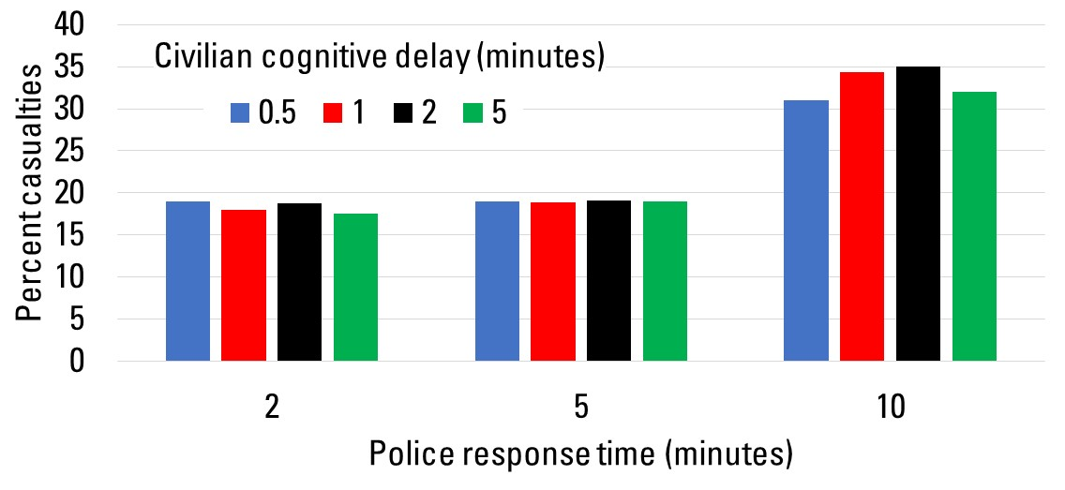
Percent of casualties by cognitive delay when all civilians hide
11
Notes:
Graph showing raw data for when the civilian response strategy is for all civilians to hide. Seeing different trends here.
Unlike the response strategy of run, there is not a clear distinction between the 5-minute cognitive delay and any of the other cognitive delay times when the strategy is to hide. For the 10-minute response time, there is a bit more variation in the data, with the 30-second and 5-minute cognitive delays indicates slightly fewer casualties, 3-4% fewer, than the 1-minute or 2-minute cognitive delay times. This is including more model variation for the number of rooms the shooter has time to enter, as his speed changes and he has a longer time for those model changes to show.
Again, there is a clear increase in percentage of casualties between the police response times; the average percentage of casualties for the 2-minute police response time was 18.7%, then 24.3% for the 5-minute police response time, and 33% for the 10-minute police response time.

Slide 12
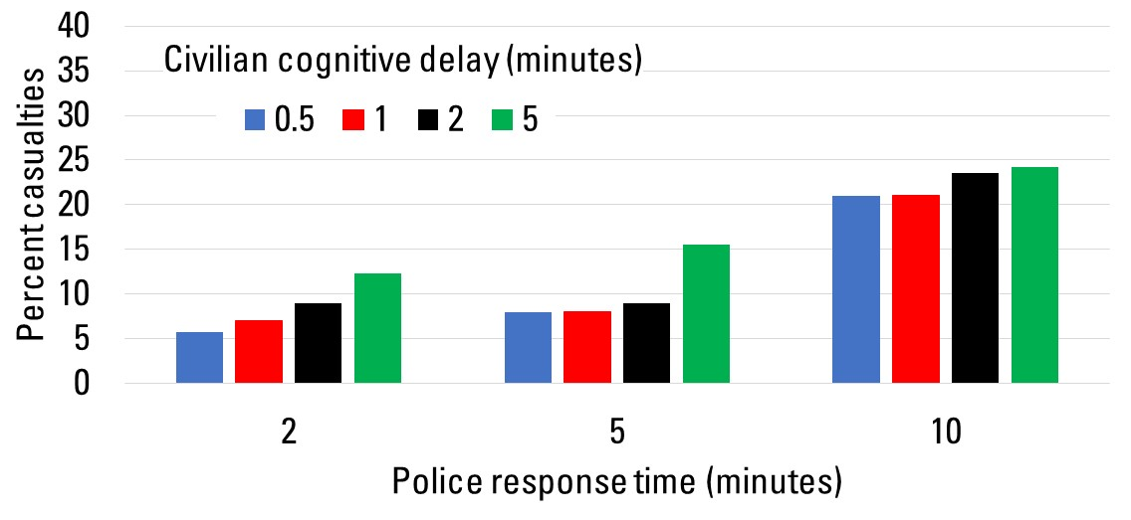
Percent of casualties by cognitive delay when some civilians run and some hide
12
Notes:
Graph showing raw data for when the civilian response strategy is for all civilians to run. Seeing a bit more like what we saw when all the civilian run.
This response strategy suggests a more obvious increasing trend than the prior 2 response strategies in the number of casualties as the cognitive delay time increased. As the police response time increased from the 2-minute and 5-minute to the 10-minute, the cognitive delay has a lesser impact on the number of casualties.
As with both the other situations, there was also an increase in the percentage of casualties as the police response time increased, though the difference is smaller than before between the 2-minute and 5-minute police response times. The average number of casualties between these two scenarios went from 8.5% to 10.5%, and then jumped up to 22.5% for the 10-minute police response time.

Slide 13
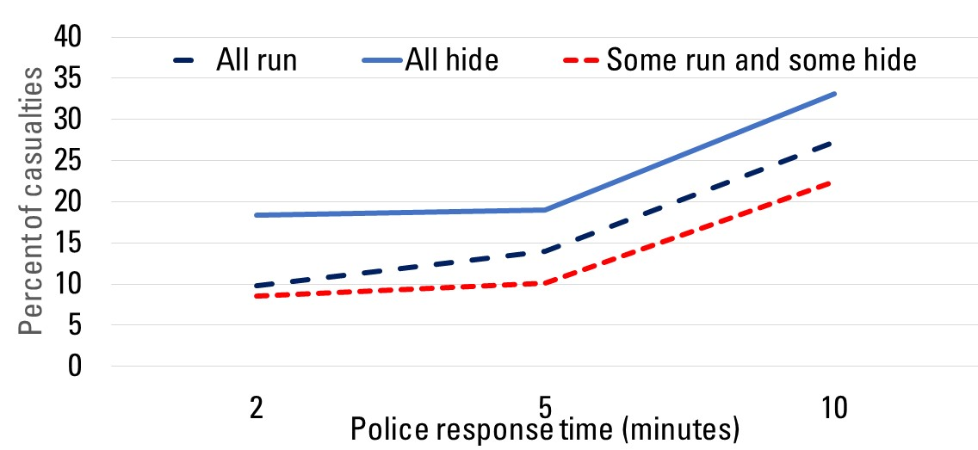
Percent of casualties averaged across all cognitive delays for each strategy
13
Notes:
This figure shows the percent of casualties across all cognitive delays for each civilian response strategy.
The all hide response strategy has the highest number of casualties across all police response times. The some run and some hide strategy had the lower number of casualties across all police response times, and the all run strategy always lies somewhere in the middle. There is a larger gap between all hide and the other two response strategies when the police response time is lower; at a 2-minute police response time the some run and some hide and all run strategies are in the 8.5-10% range while the all hide strategy is at about 19%. As the police response time increases, the all run response strategy increases and moves closer to the number of casualties in the all hide strategy, and somewhat bridges that gap.

Slide 14
Design of experiments
First-order and interaction effects
Model significant at 0.0001 level, R² = 0.84
Three first-order variables significant
Results
Police response time: 1 minute decrease → 2% decrease in casualties
Cognitive delay:
If all civilians run, 1 minute decrease → 2% decrease in casualties
If some civilians run and some hide, 1 minute decrease → 1% decrease in casualties
Notes:
Next, a model was then constructed and an ANOVA table was created using all of the 1800 collected data points over the 36 different scenarios. The model effects included the three individual parameters, all significant, and the significant interactions between parameters, which included civilian response strategy * police response time and civilian response strategy * cognitive delay. The model summary of fit reported an R² value of 0.843. The ANOVA table indicates that much of the variability is accounted for by the model, and the unexplained random error is low. The F-ratio in the ANOVA table is 1211.17, which results in a p-value of less than 0.0001.
Next, the parameter estimates were observed and the prediction equation was created – this is shown here broken down by civilian response strategy. 4% for intercept in evacuate. 12% intercept in hide. 0.2% intercept in combo. Police response time adds 2% per minute. Cognitive delay adds 1% per minute. Then, look at the interaction terms as well. Though it was significant, the parameter estimates are very low for the interaction term of civilian response strategy * police response time. The parameter estimates are more significant for cognitive delay with civilian response strategy. Example: For the evacuate response strategy, if cognitive delay is 1 minute, the interaction term would indicate a 1% decrease in the number of casualties. If cognitive delay is 5 minutes, the interaction term would indicate approximately a 3% increase in casualties.

Slide 15
Conclusions
Data for active shootings is limited: simulation can help estimate parameters
Simulations can assess a wide variety of active shooter situations
Quicker law enforcement response: casualties decrease by 2% per minute of response
Slower civilian response: casualties increase by 1-2% per minute of delay
Civilians hiding can lead to more casualties
Need to validate simulation models
Email: camacken@iastate.edu
15
Notes:
Like I’ve mentioned, data for active shootings is limited. We don’t want to increase real-life data points, but it is ideal to gather the most information possible about these situations to analyze response strategies. Simulations can help us estimate the effects of these parameters without any additional real-life data points being added.
Simulations allow us to asses a wide variety of active shooter situations in a short time period, and see the affects that changing various parameters has on the number of casualties. Creating simulation models is a good way to assess parameters such as civilian response strategy, police response time, and cognitive delay, as done in this model, along with other variables used by previous researchers, such as shooter magazine capacity, the presence of security guards or civilians with concealed carry weapons, or the percentage of unarmed civilians who are willing to engage the attacker.
Results of the simulation model indicate:
A faster law enforcement response time is an effective way to decrease the number of casualties, by approximately2% per minute
Lengthy cognitive delays can increase the number of casualties, by approximately 1% per minute
The best response strategy simulated is for some civilians to run and some to hide, and the worst strategy is for all civilians to hide.

Slide 16
References
Anklam, C., Kirby, A., Sharevski, F., & Dietz, J. E. (2015). Mitigating active shooter impact: analysis for policy options based on agent/computer-based modeling. Journal of emergency management, 13(3), p. 201-216.
Blair, J. Pete, and Schweit, Katherine W. (2014). A Study of Active Shooter Incidents, 2000- 2013. Texas State University and Federal Bureau of Investigation, US Department of Justice, Washington, D.C.
Briggs, T. W. & Kennedy, W. G. (2016). Active shooter: An agent-based model of unarmed resistance. In 2016 Winter Simulation Conference (WSC) (pp. 3521-3531)
Davidsson P., Holmgren J., Kyhlbäck H., Mengistu D., Persson M. (2007). Applications of Multi Agent-Based Simulation, Multi-Agent-Based Simulation VII, LNAI, Vol. 4442, Springer.
Hayes, Roy and Hayes, Reginald (2014) “Agent-Based Simulation of Mass Shootings: Determining How to Limit the Scale of a Tragedy.” Journal of Artificial Societies and Social Simulation 17 (2) 5 <http://jasss.soc.surrey.ac.uk/17/2/5.html>.
Kirby, Adam, Anklam, Charles E. III, and Dietz, Eric J. (2016). “Active Shooter Mitigation For Gun-Free Zones.” Proceedings from 2016 IEEE Symposium on Technologies for Homeland Security (HST).
U.S. Department of Homeland Security. (2017). Active Shooter: How to Respond Poster. Retrieved from <https://www.dhs.gov/publication/active-shooter-poster#>.
16
16

Slide 17
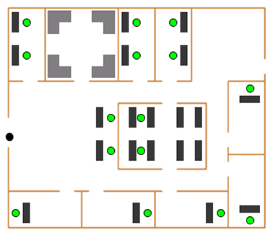
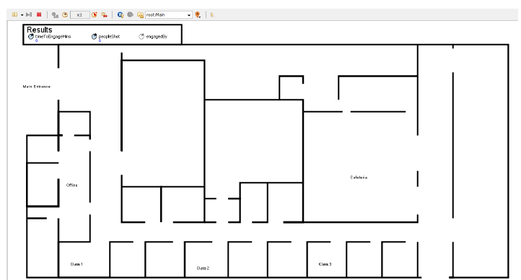
Literature Review
Benefits and limitations of active shooter agent-based simulations
Source: Kirby, Anklam, Sharevski, and Dietz, 2015
Source: Kirby, Adam, Anklam, and Dietz, 2016

Slide 18
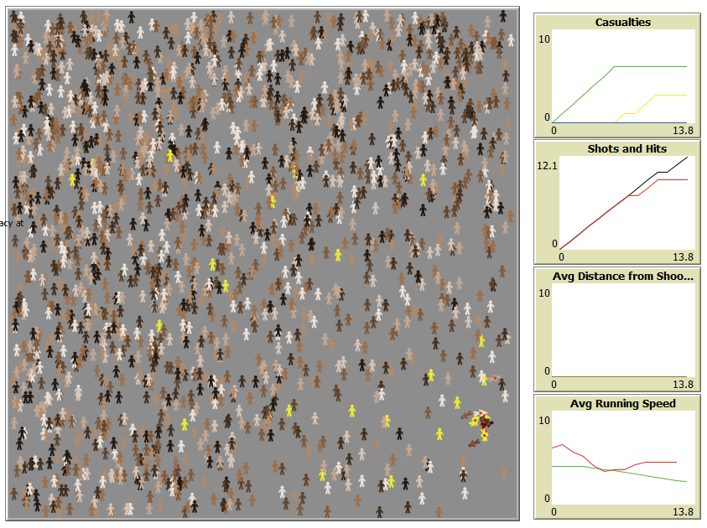
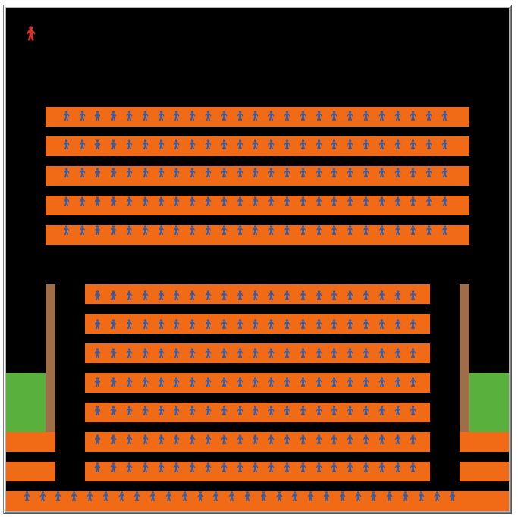
Literature Review
Source: Hayes and Hayes, 2014
Source: Briggs and Kennedy, 2016

Slide 19
Statistical Difference in Means
Notes:
Getting more into the statistical analysis piece, a Tukey test was performed on each of the three parameters to see if each parameter had means that were statistically different from each other.
For the civilian response strategy, the Tukey analysis revealed significantly different means for each of the three strategies.
For police response time, the analysis also showed significantly different means for each of the three response times.
For cognitive delay, the analysis showed that the 5-minute delay was significantly different from the other three delay times, but the other three were not significantly different from each other.

